Slide 1

Computer Vision
Naeemullah Khan
naeemullah.khan@kaust.edu.sa
KAUST Academy
King Abdullah University of Science and Technology
January 07, 2024
Computer Vision

Slide 2
Object Detection
▶ Input: Single RGB Image
▶ Output: A set of detected objects. For each object predict:
Category label (from fixed, known set of categories)
Bounding box (four numbers: x, y, width, height)

Slide 3
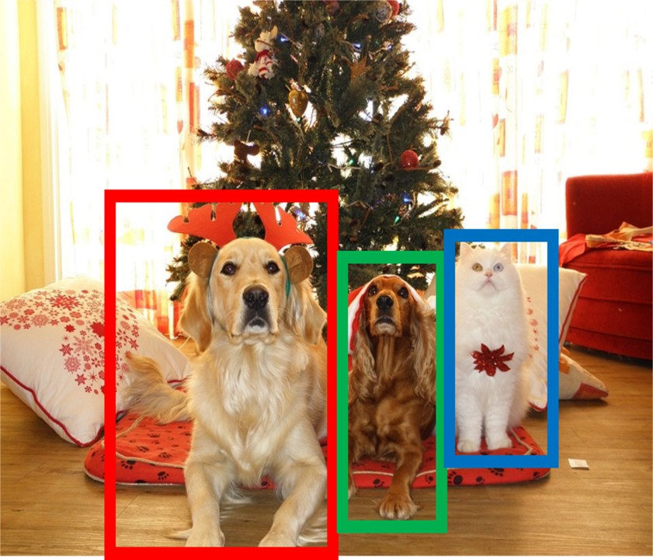
Object Detection (cont.)

Slide 4
Object Detection: Challenges
▶ Multiple outputs: Need to output variable numbers of objects per image
▶ Multiple types of output: Need to predict ”what” (category label) as well as ”where” (bounding box)
▶ Large images: Classification works at 224x224; need higher resolution for detection, often ∼ 800 × 600

Slide 5
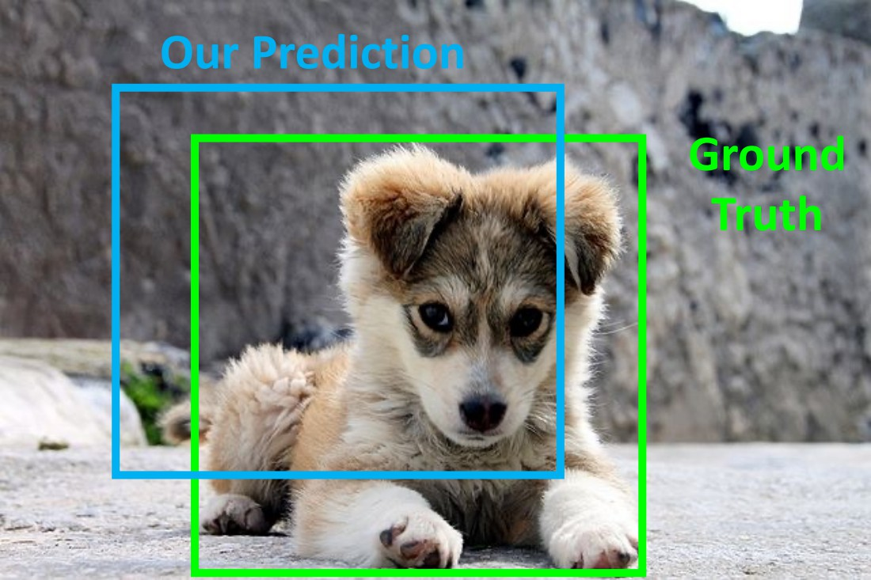
Comparing Boxes: Intersection over Union (IoU)
▶ How can we compare our prediction to the ground-truth box?

Slide 6
Comparing Boxes: Intersection over Union (IoU)
▶ How can we compare our prediction to the ground-truth box?
▶ Intersection over Union (IoU) (Also called ”Jaccard similarity” or ”Jaccard index”):
Area of Intersection Area of Union

Slide 7
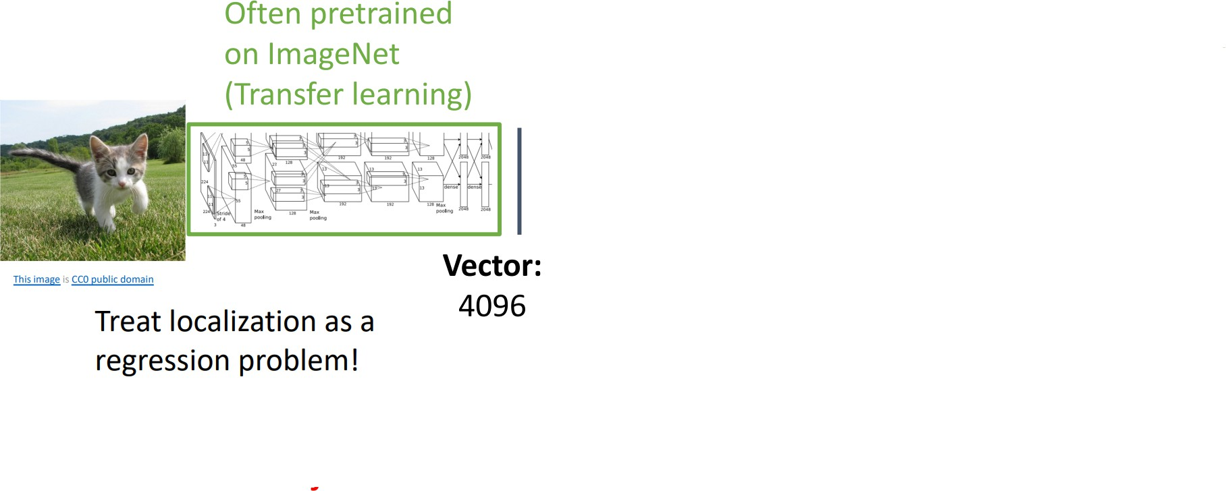
Detecting a Single Object

Slide 8
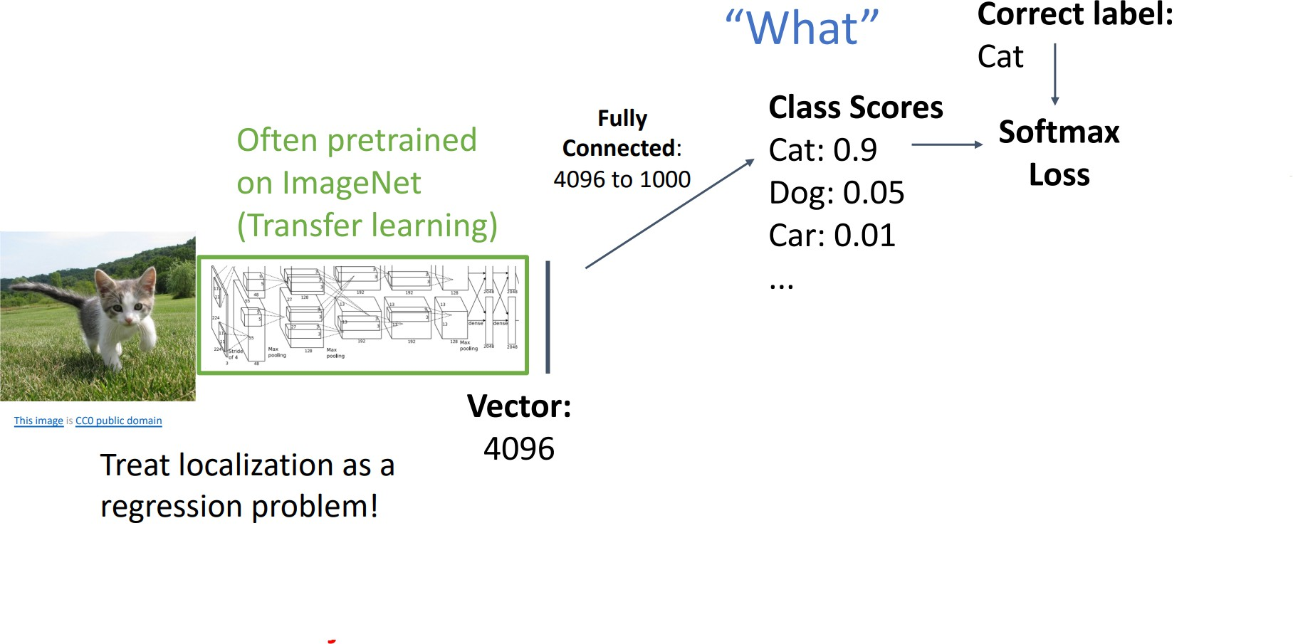
Detecting a Single Object (cont.)

Slide 9
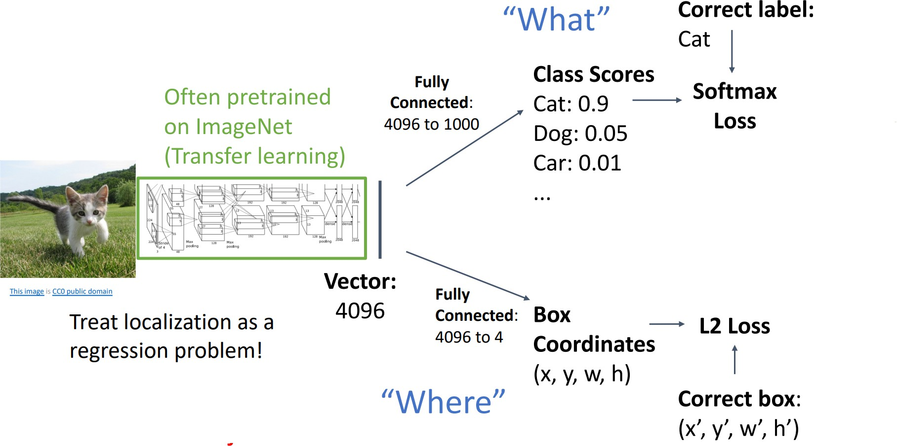
Detecting a Single Object (cont.)

Slide 10
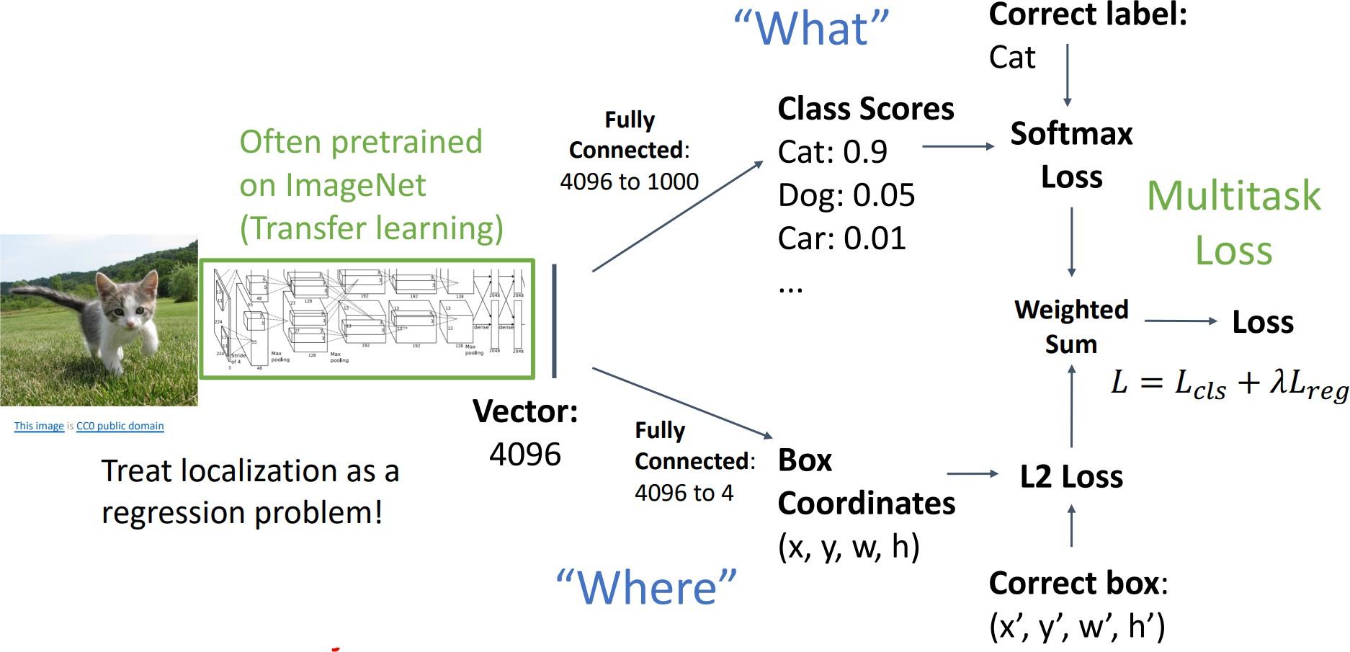
Detecting a Single Object (cont.)

Slide 11
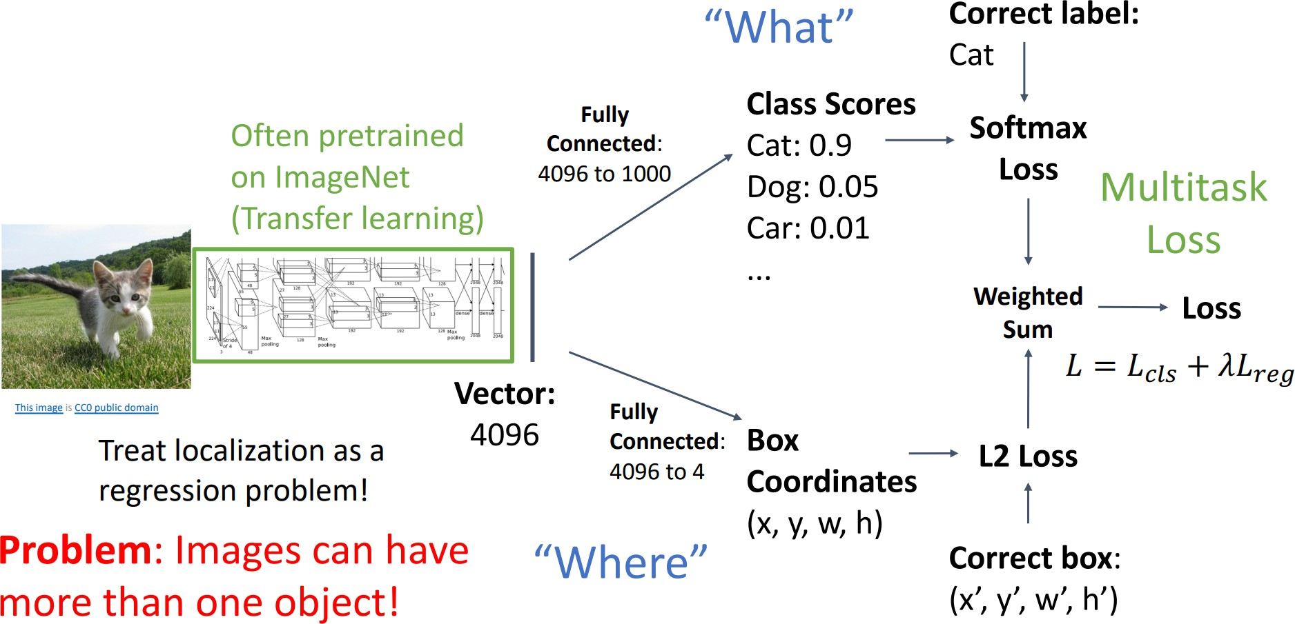
Detecting a Single Object (cont.)

Slide 12
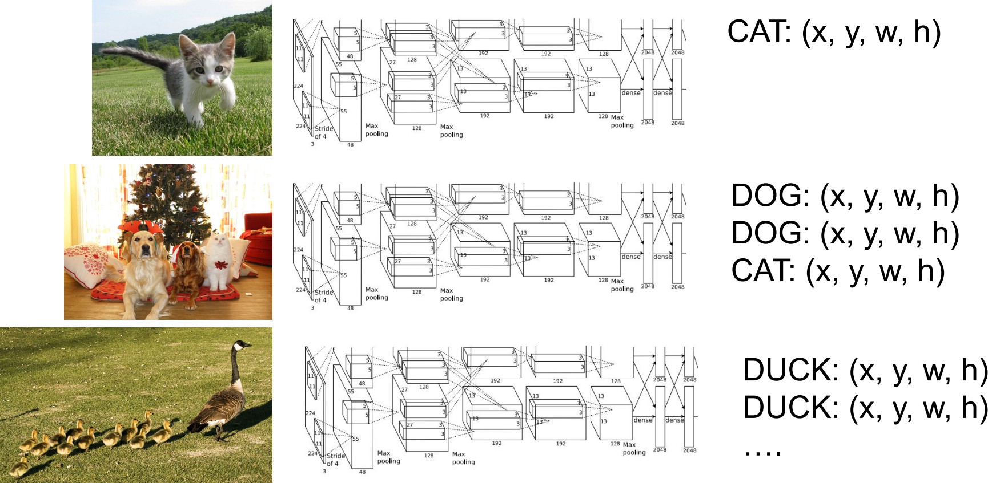
Multiple Objects

Slide 13
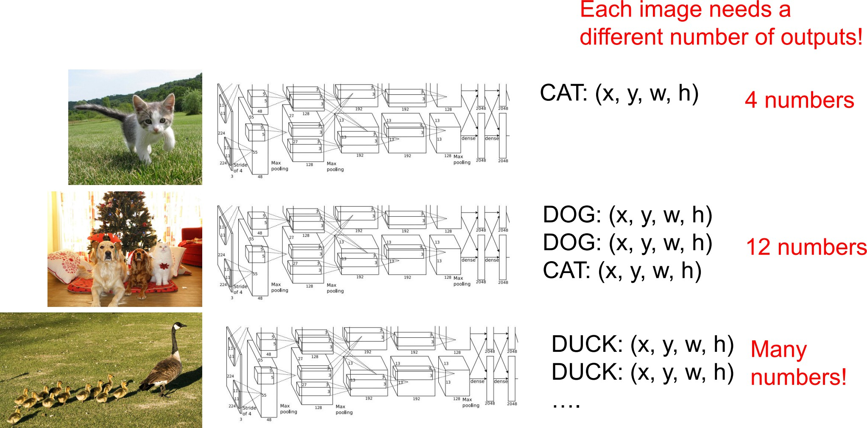
Multiple Objects (cont.)

Slide 14
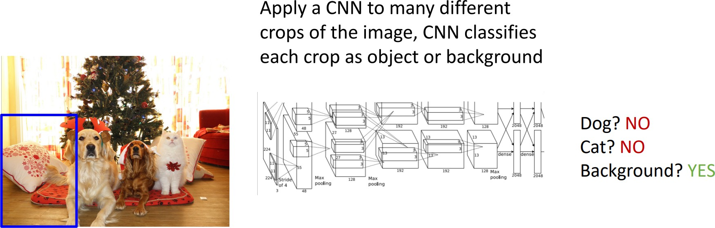
Detecting Multiple Objects: Sliding Window

Slide 15
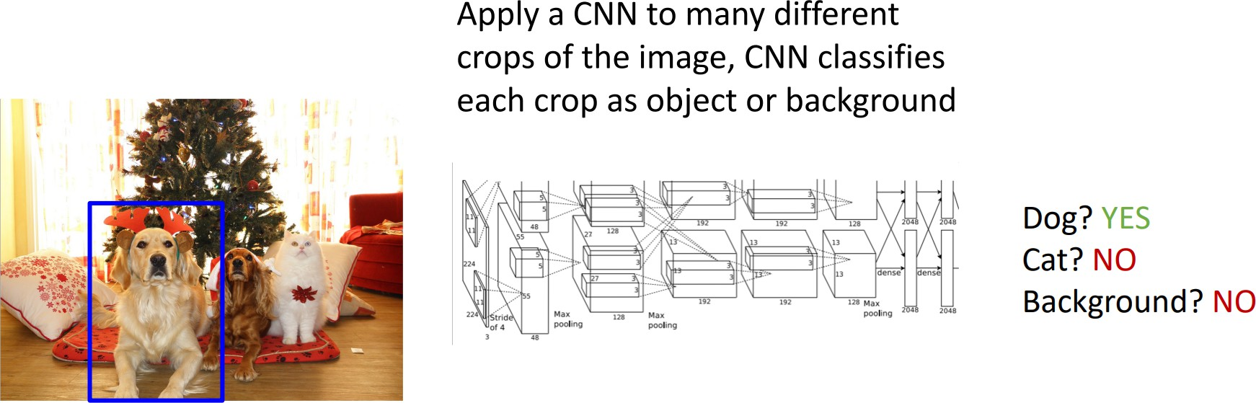
Detecting Multiple Objects: Sliding Window (cont.)

Slide 16
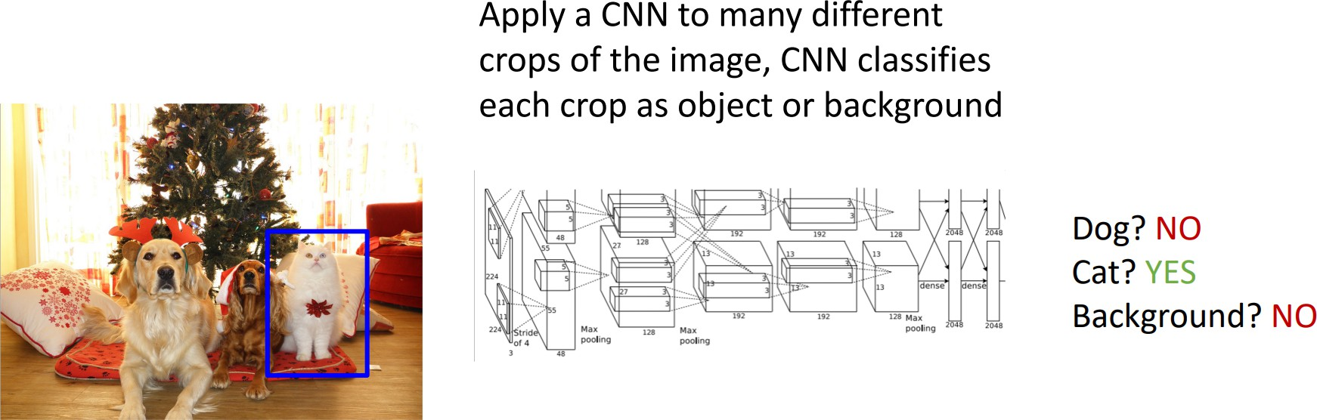
Detecting Multiple Objects: Sliding Window (cont.)

Slide 17
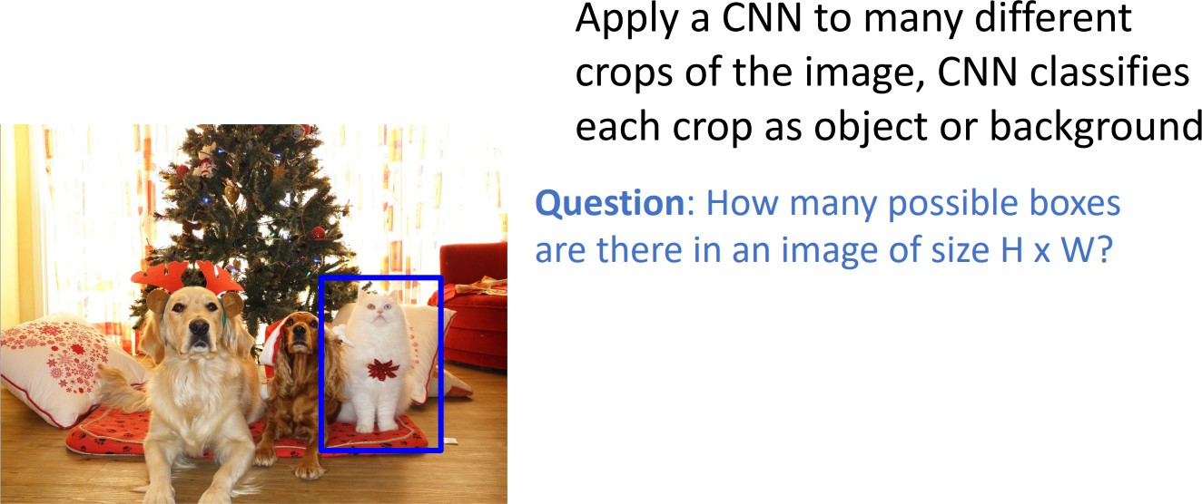
Detecting Multiple Objects: Sliding Window (cont.)

Slide 18
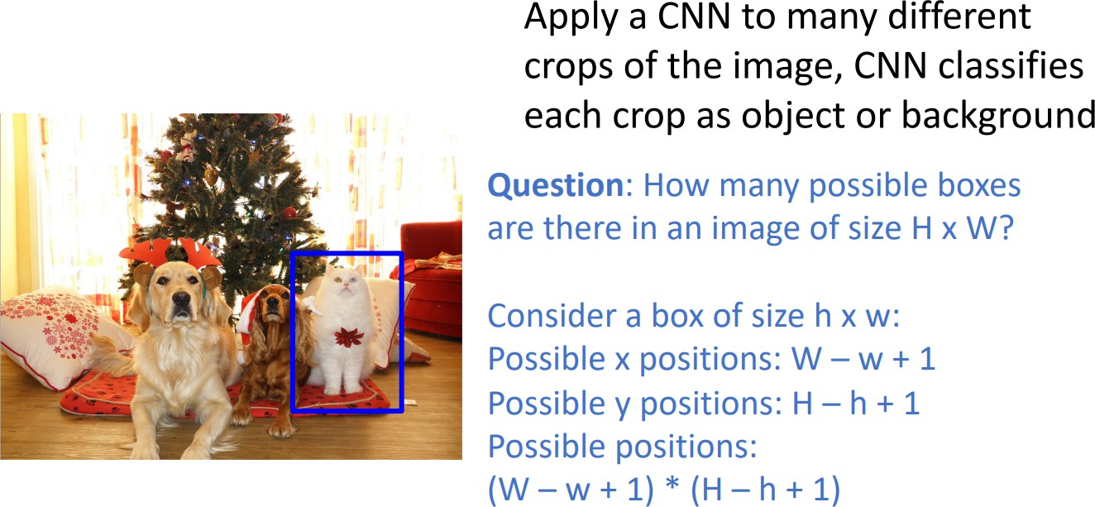
Detecting Multiple Objects: Sliding Window (cont.)

Slide 19
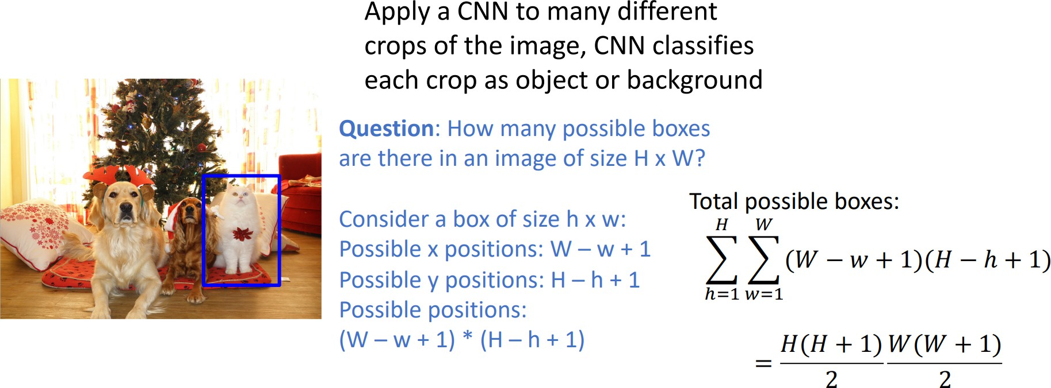
Detecting Multiple Objects: Sliding Window (cont.)

Slide 20
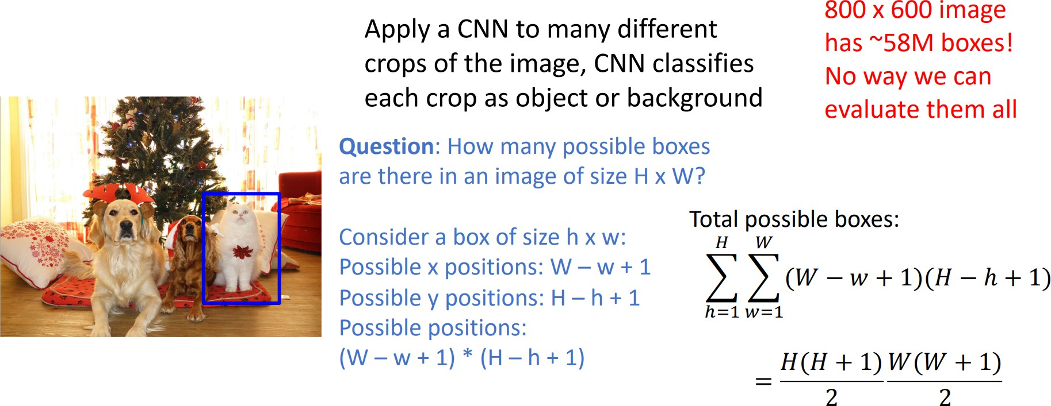
Detecting Multiple Objects: Sliding Window (cont.)

Slide 21
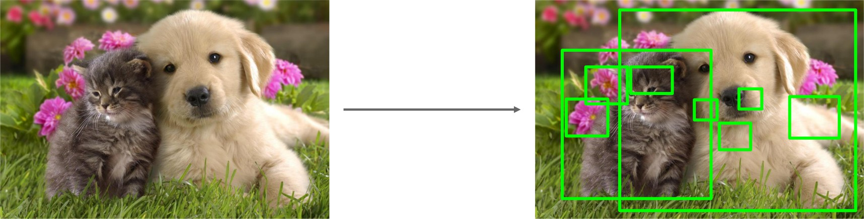
Region Proposal
▶ Find a small set of boxes that are likely to cover all objects
▶ Often based on heuristics: e.g. look for “blob-like” image regions
▶ Relatively fast to run; e.g. Selective Search gives 2000 region proposals in a few seconds on CPU

Slide 22
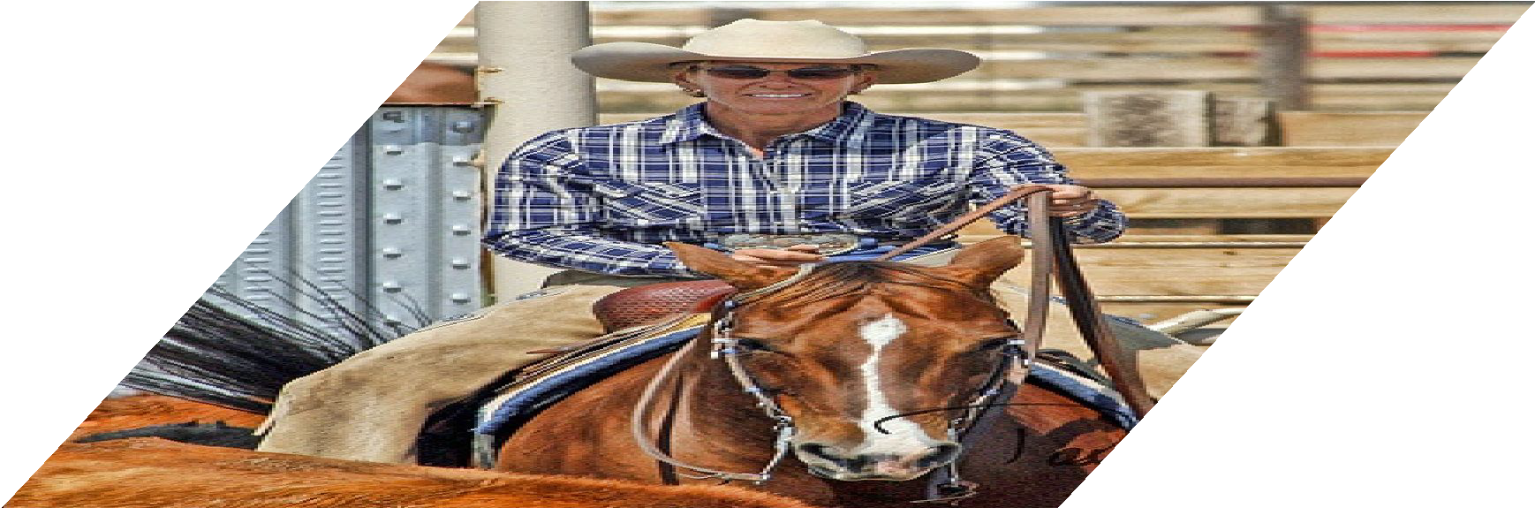
R-CNN
Input image
Girshick et al, “Rich feature hierarchies for accurate object detection and semantic segmentation”, CVPR 2014.
Figure copyright Ross Girshick, 2015; source. Reproduced with permission.

Slide 23
R-CNN
Regions of Interest (RoI) from a proposal method (~2k)
Input image
Girshick et al, “Rich feature hierarchies for accurate object detection and semantic segmentation”, CVPR 2014.
Figure copyright Ross Girshick, 2015; source. Reproduced with permission.

Slide 24
R-CNN
Warped image regions (224x224 pixels)
Regions of Interest (RoI) from a proposal method (~2k)
Input image
Girshick et al, “Rich feature hierarchies for accurate object detection and semantic segmentation”, CVPR 2014.
Figure copyright Ross Girshick, 2015; source. Reproduced with permission.

Slide 25


R-CNN
ConvN et
Forward each region through ConvNet (ImageNet-pretranied)
ConvN et
ConvN et
Warped image regions (224x224 pixels)
Regions of Interest
(RoI) from a proposal method (~2k)
Input image
Girshick et al, “Rich feature hierarchies for accurate object detection and semantic segmentation”, CVPR 2014.
Figure copyright Ross Girshick, 2015; source. Reproduced with permission.

Slide 26



R-CNN
SVMs
Classify regions with SVMs
SVMs
SVMs
Forward each region through ConvNet (ImageNet-pretranied)
ConvN et
ConvN et
ConvN et
Warped image regions (224x224 pixels)
Regions of Interest
(RoI) from a proposal method (~2k)
Input image
Girshick et al, “Rich feature hierarchies for accurate object detection and semantic segmentation”, CVPR 2014.
Figure copyright Ross Girshick, 2015; source. Reproduced with permission.

Slide 27


R-CNN
Predict “corrections” to the RoI: 4 numbers: (dx, dy, dw, dh)
Bbox reg
SVMs
Classify regions with SVMs
Bbox reg
SVMs
Bbox reg
SVMs
Forward each region through ConvNet (ImageNet-pretranied)
ConvN et
ConvN et
ConvN et
Warped image regions (224x224 pixels)
Regions of Interest
(RoI) from a proposal method (~2k)
Input image
Girshick et al, “Rich feature hierarchies for accurate object detection and semantic segmentation”, CVPR 2014.
Figure copyright Ross Girshick, 2015; source. Reproduced with permission.

Slide 28
R-CNN
Predict “corrections” to the RoI: 4 numbers: (dx, dy, dw, dh)
Bbox reg
SVMs
Classify regions with SVMs
Problem: Very slow! Need to do ~2k independent forward passes for each image!
Bbox reg
SVMs
Bbox reg
SVMs
Forward each region through ConvNet
ConvN et
ConvN et
ConvN et
Warped image regions (224x224 pixels)
Regions of Interest
(RoI) from a proposal method (~2k)
Input image
Girshick et al, “Rich feature hierarchies for accurate object detection and semantic segmentation”, CVPR 2014.
Figure copyright Ross Girshick, 2015; source. Reproduced with permission.

Slide 29


“Slow” R-CNN
R-CNN
Predict “corrections” to the RoI: 4 numbers: (dx, dy, dw, dh)
Bbox reg
SVMs
Classify regions with SVMs
Problem: Very slow! Need to do ~2k independent forward passes for each image!
Bbox reg
SVMs
Bbox reg
SVMs
Forward each region through ConvNet
ConvN et
ConvN et
Idea: Pass the image through convnet before cropping! Crop the conv feature instead!
ConvN et
Warped image regions (224x224 pixels)
Regions of Interest
(RoI) from a proposal method (~2k)
Input image
Girshick et al, “Rich feature hierarchies for accurate object detection and semantic segmentation”, CVPR 2014.
Figure copyright Ross Girshick, 2015; source. Reproduced with permission.

Slide 30
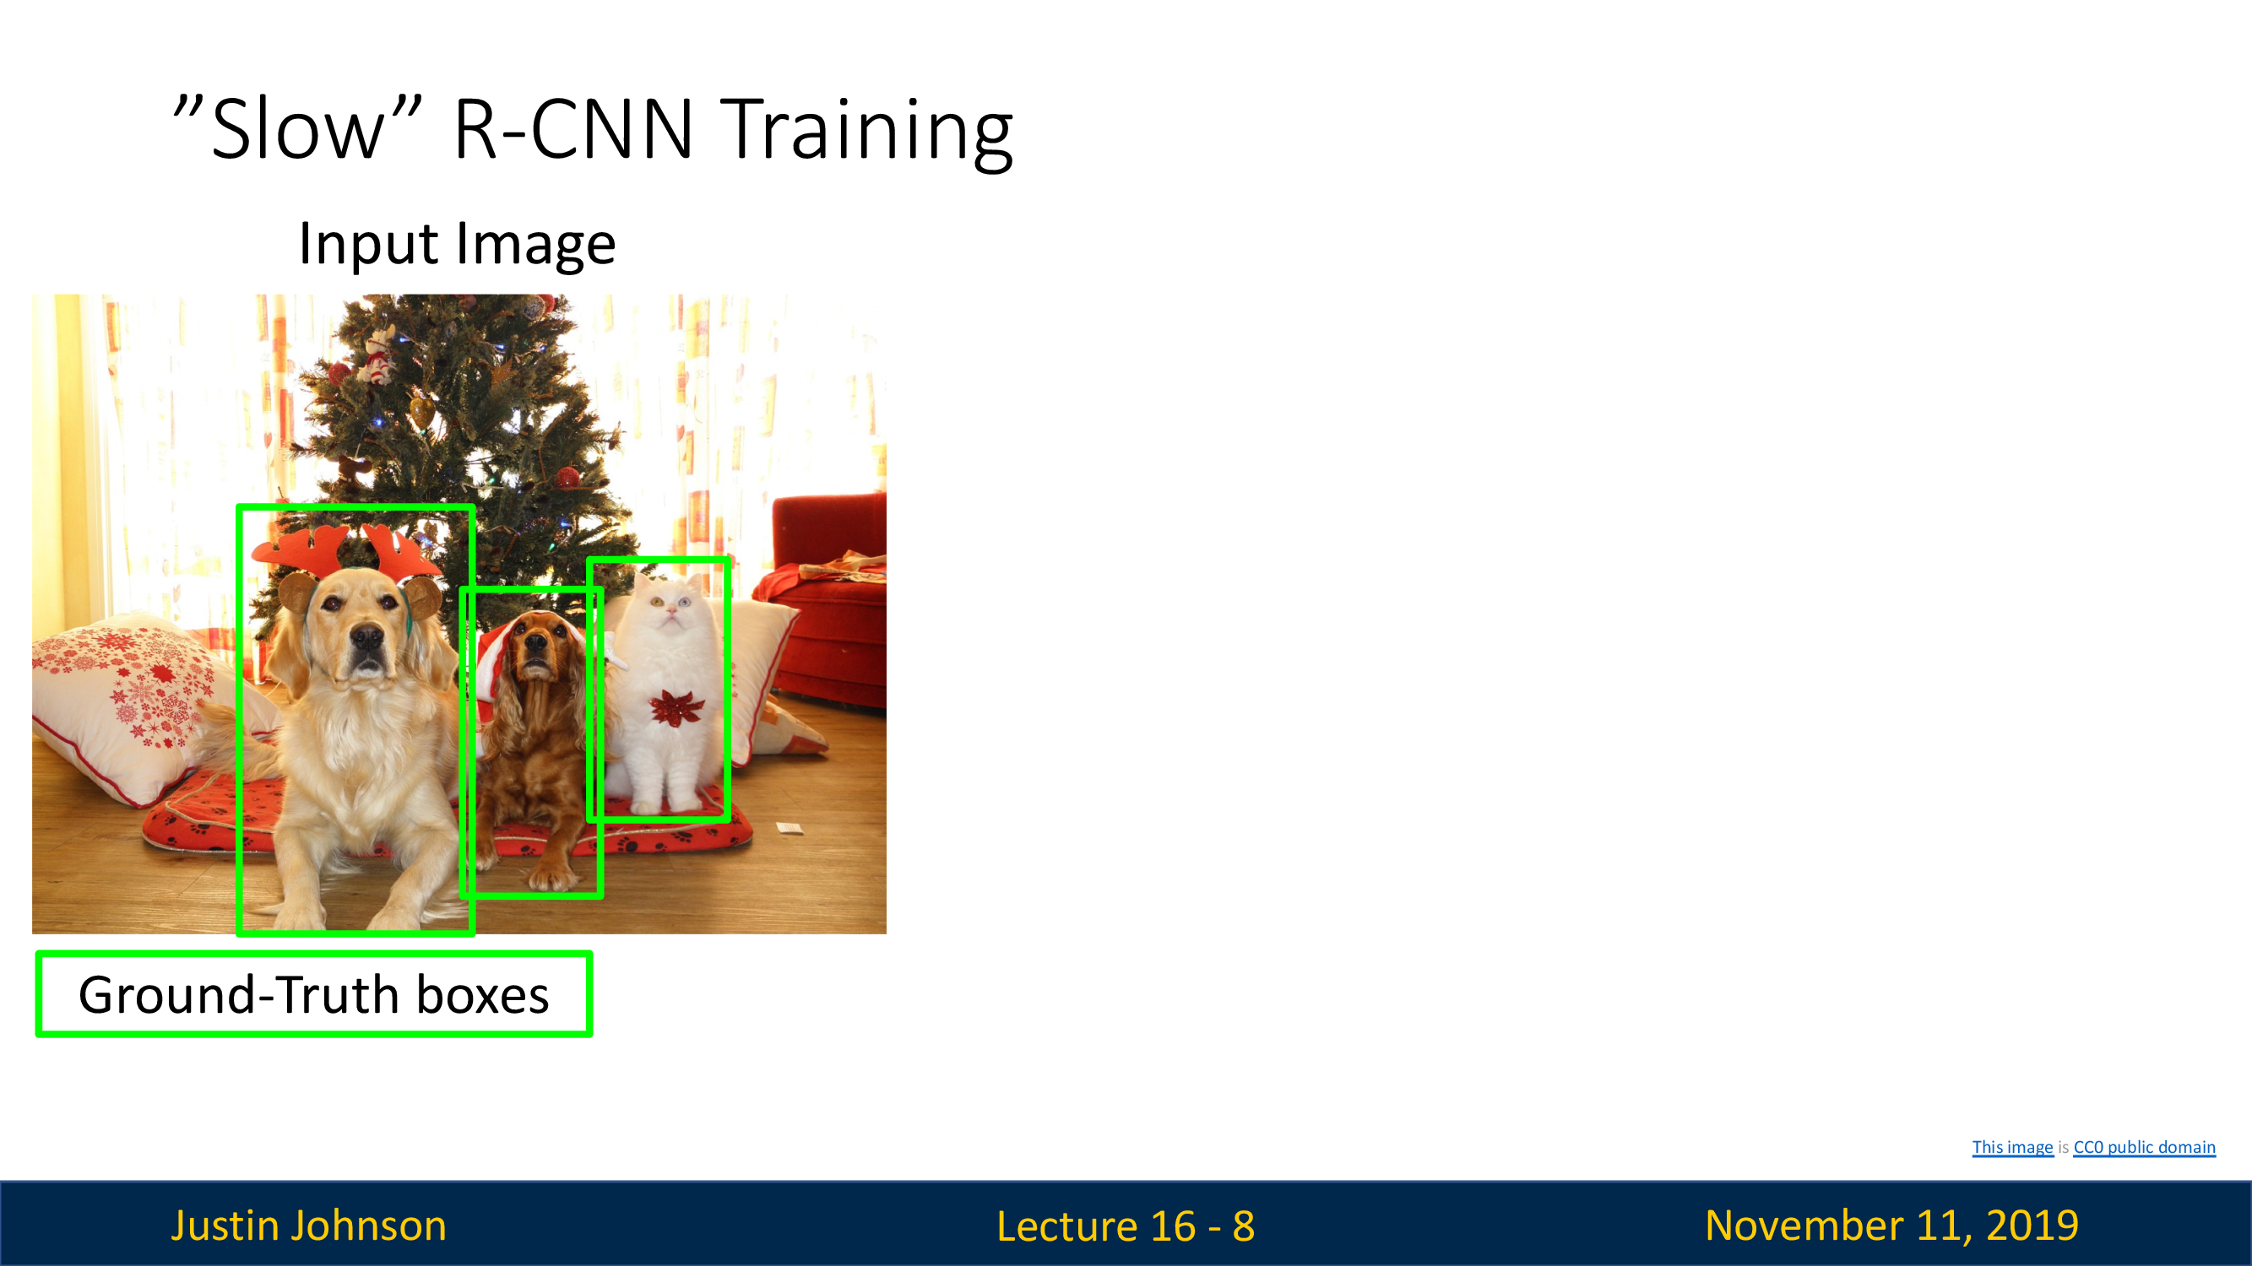
R-CNN

Slide 31
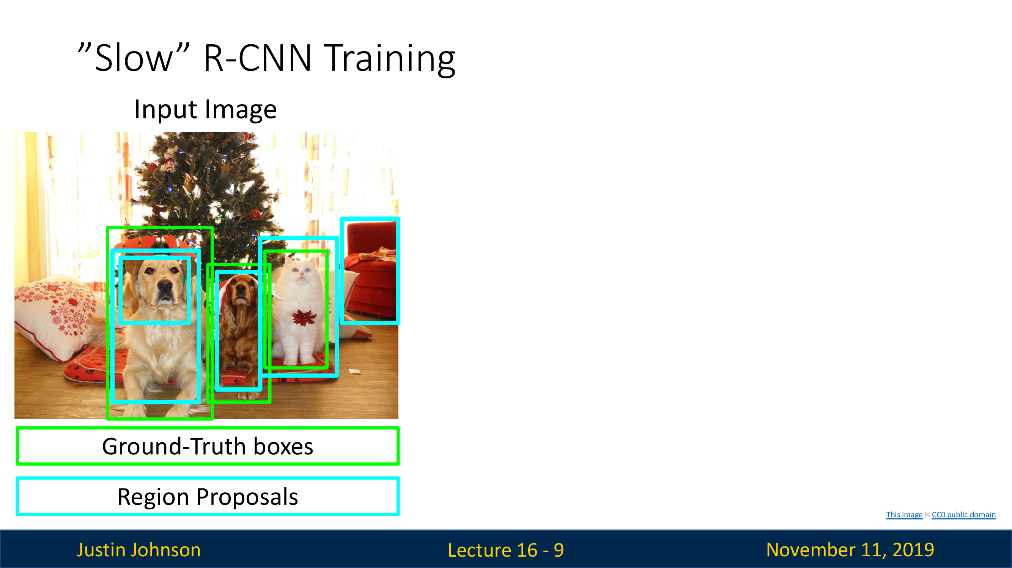
R-CNN

Slide 32
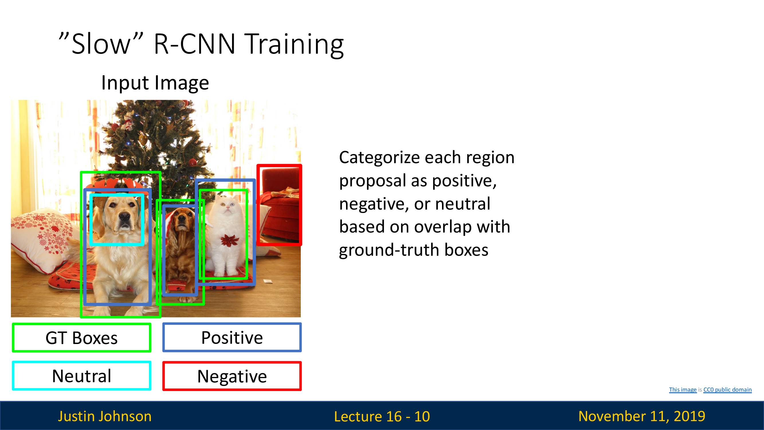
R-CNN

Slide 33
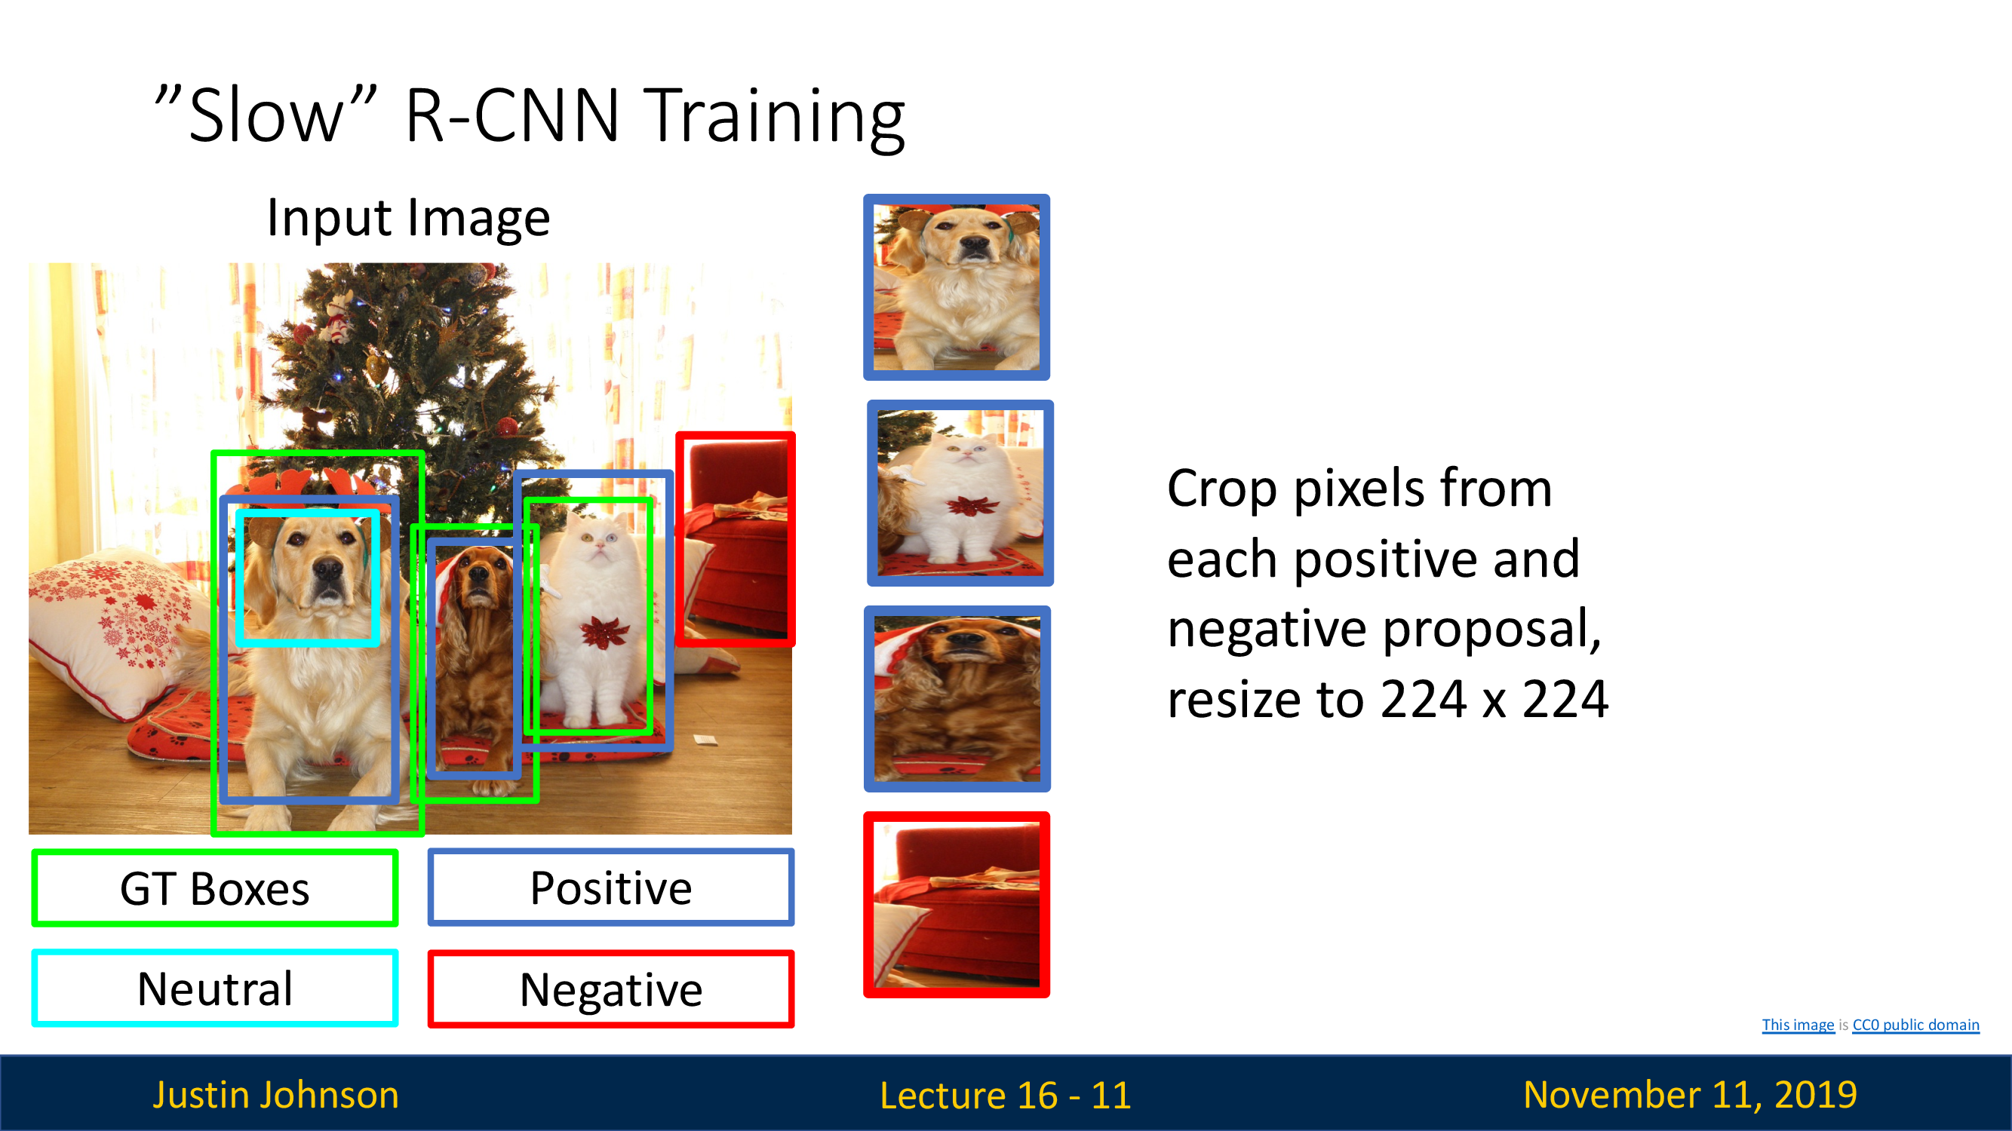
R-CNN

Slide 34
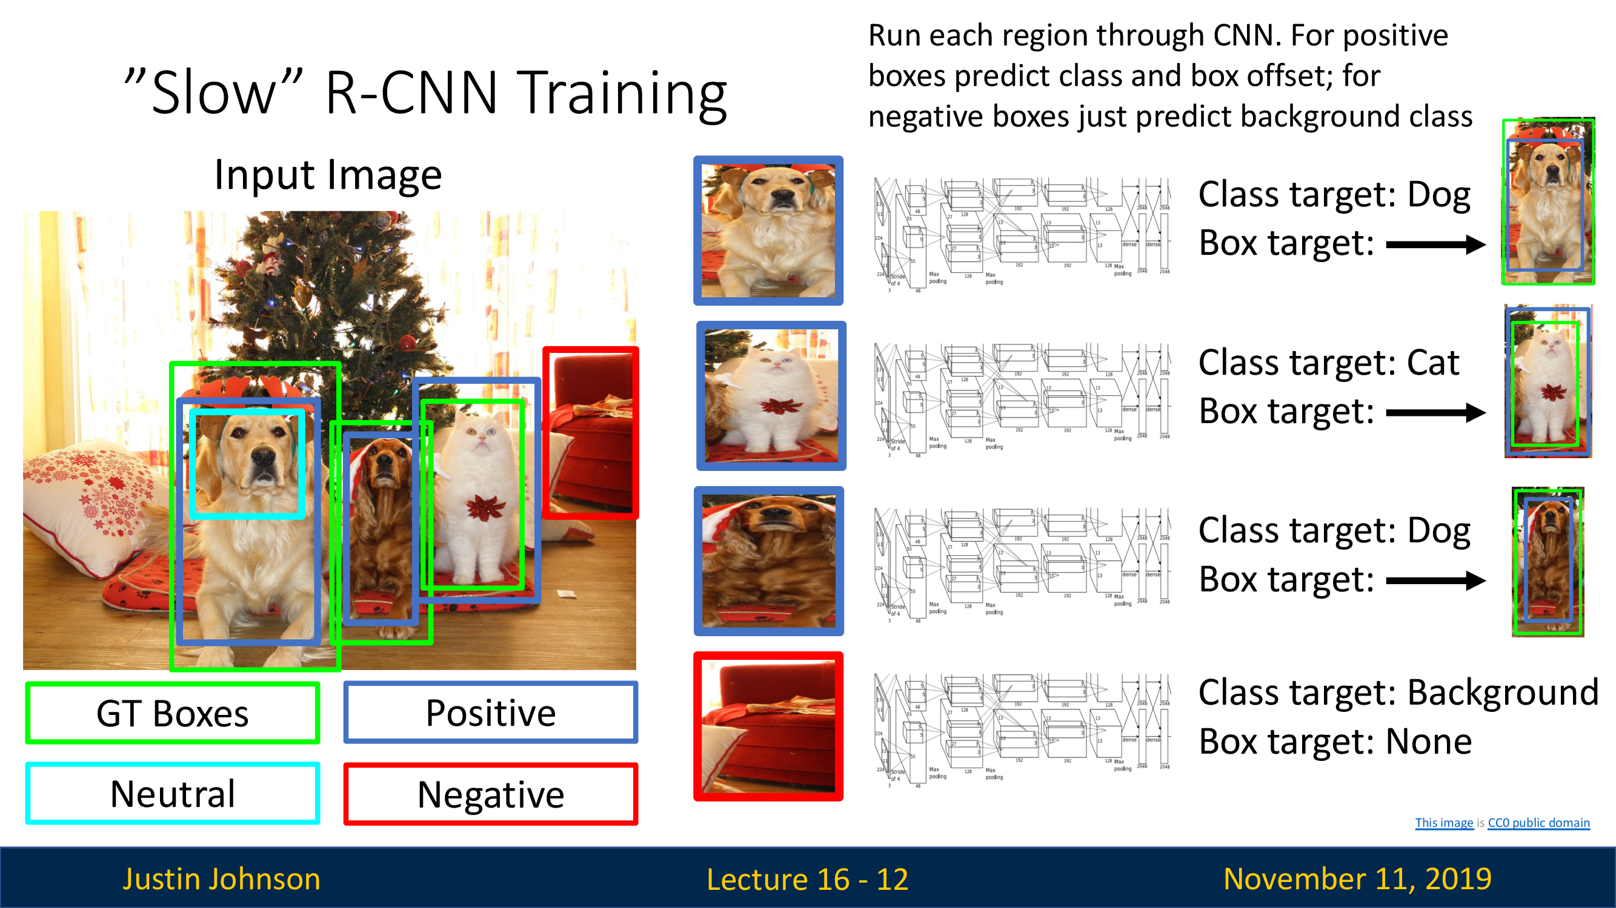
R-CNN

Slide 35
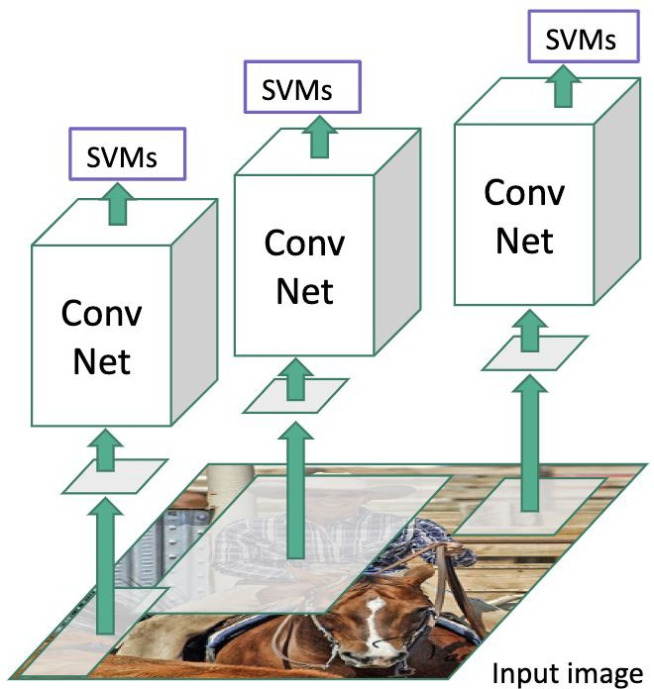

Fast R-CNN
“Slow” R-CNN
Input image
Girshick, “Fast R-CNN”, ICCV 2015. Figure copyright Ross Girshick, 2015; source. Reproduced with permission.

Slide 36

Fast R-CNN
“Slow” R-CNN
“conv5” features
“Backbone” network: AlexNet, VGG, ResNet, etc
Run whole image through ConvNet
ConvNet
Input image
Girshick, “Fast R-CNN”, ICCV 2015. Figure copyright Ross Girshick, 2015; source. Reproduced with permission.

Slide 37
Fast R-CNN
Regions of Interest (RoIs) from a proposal
“Slow” R-CNN
method
“conv5” features
“Backbone” network: AlexNet, VGG, ResNet, etc
Run whole image through ConvNet
ConvNet
Input image
Girshick, “Fast R-CNN”, ICCV 2015. Figure copyright Ross Girshick, 2015; source. Reproduced with permission.

Slide 38
Fast R-CNN
Regions of Interest (RoIs) from a proposal
“Slow” R-CNN
Crop + Resize features
method
“conv5” features
“Backbone” network: AlexNet, VGG, ResNet, etc
Run whole image through ConvNet
ConvNet
Input image
Girshick, “Fast R-CNN”, ICCV 2015. Figure copyright Ross Girshick, 2015; source. Reproduced with permission.

Slide 39



Fast R-CNN
Object category
Linear + softmax
Linear
Box offset
Regions of Interest (RoIs) from a proposal
CNN
Per-Region Network
“Slow” R-CNN
Crop + Resize features
method
“conv5” features
“Backbone” network: AlexNet, VGG, ResNet, etc
Run whole image through ConvNet
ConvNet
Input image
Girshick, “Fast R-CNN”, ICCV 2015. Figure copyright Ross Girshick, 2015; source. Reproduced with permission.

Slide 40
Fast R-CNN
Object category
Linear + softmax
Linear
Box offset
Regions of Interest (RoIs)
CNN
Per-Region Network
“Slow” R-CNN
Crop + Resize features (RoI pooling layer)
from a proposal
method
“conv5” features
“Backbone” network: AlexNet, VGG, ResNet, etc
Run whole image through ConvNet
ConvNet
Input image
Girshick, “Fast R-CNN”, ICCV 2015. Figure copyright Ross Girshick, 2015; source. Reproduced with permission.

Slide 41
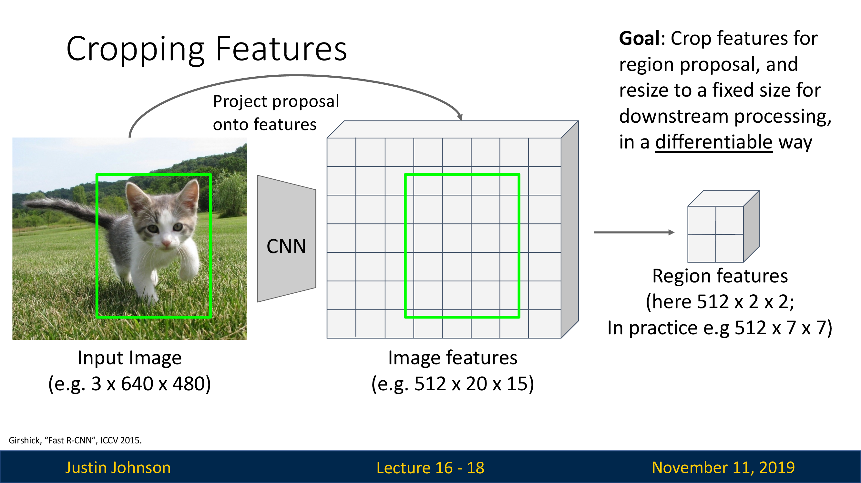
RoI pooling

Slide 42
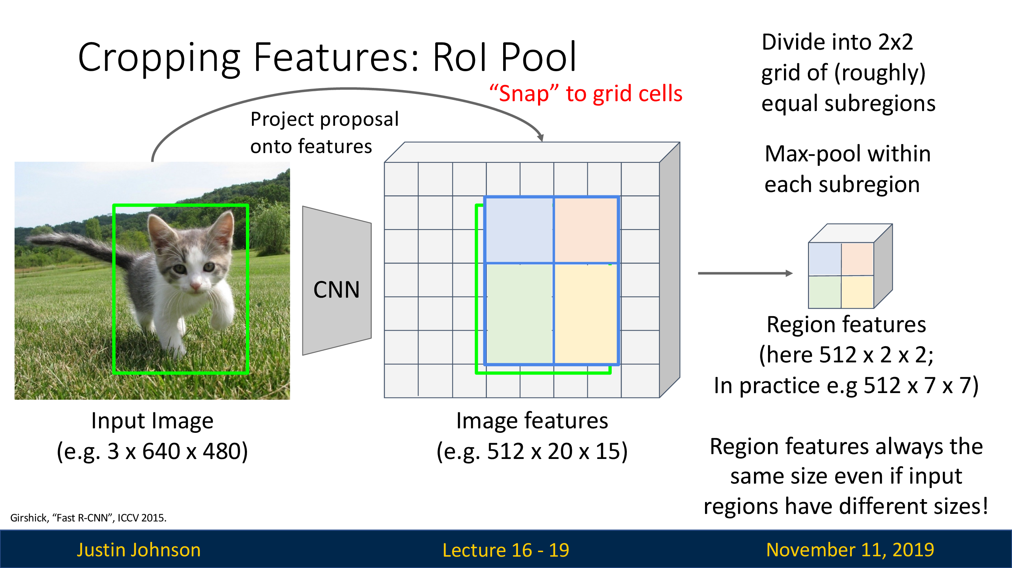
RoI pooling

Slide 43
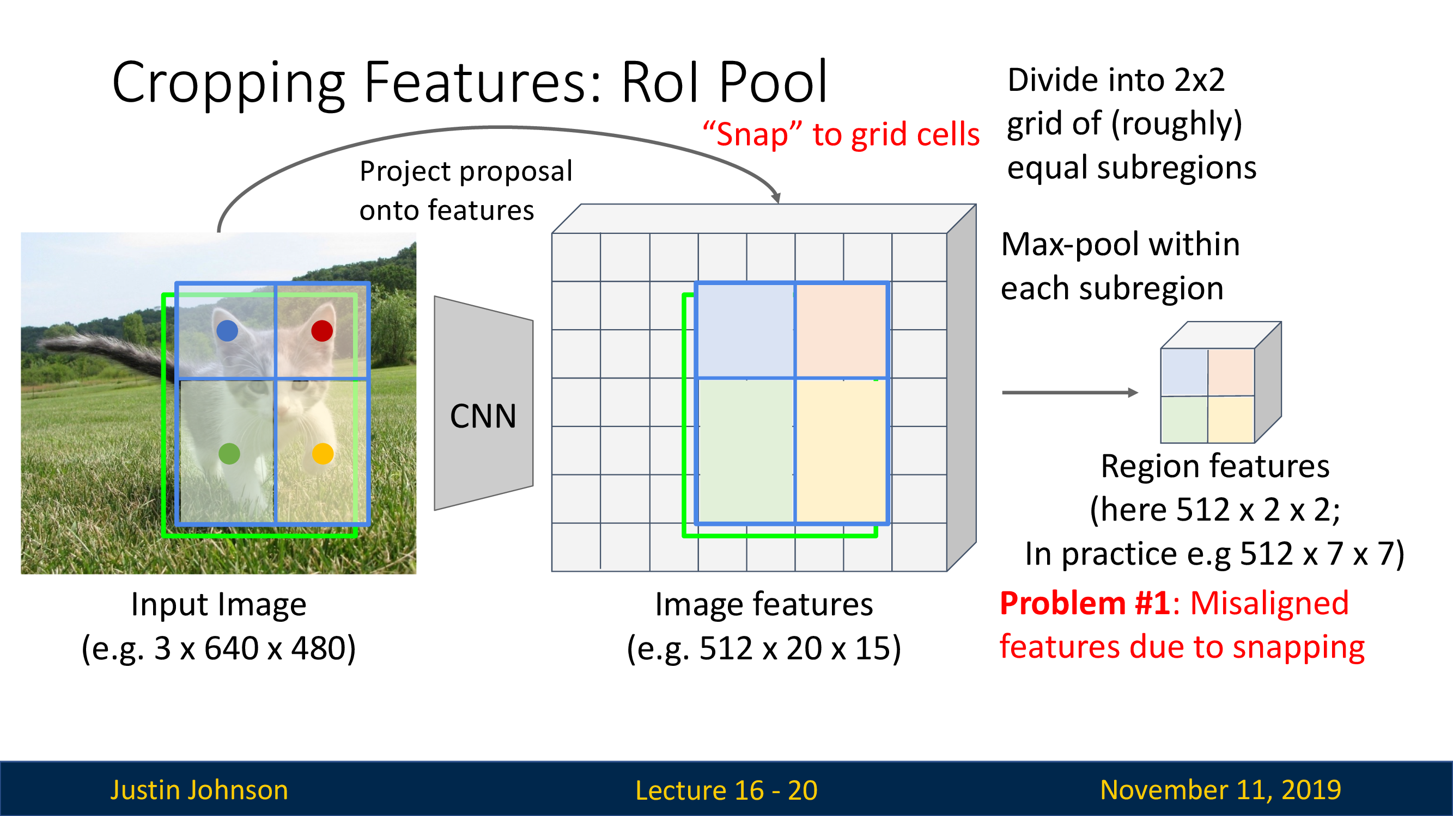
RoI pooling

Slide 44
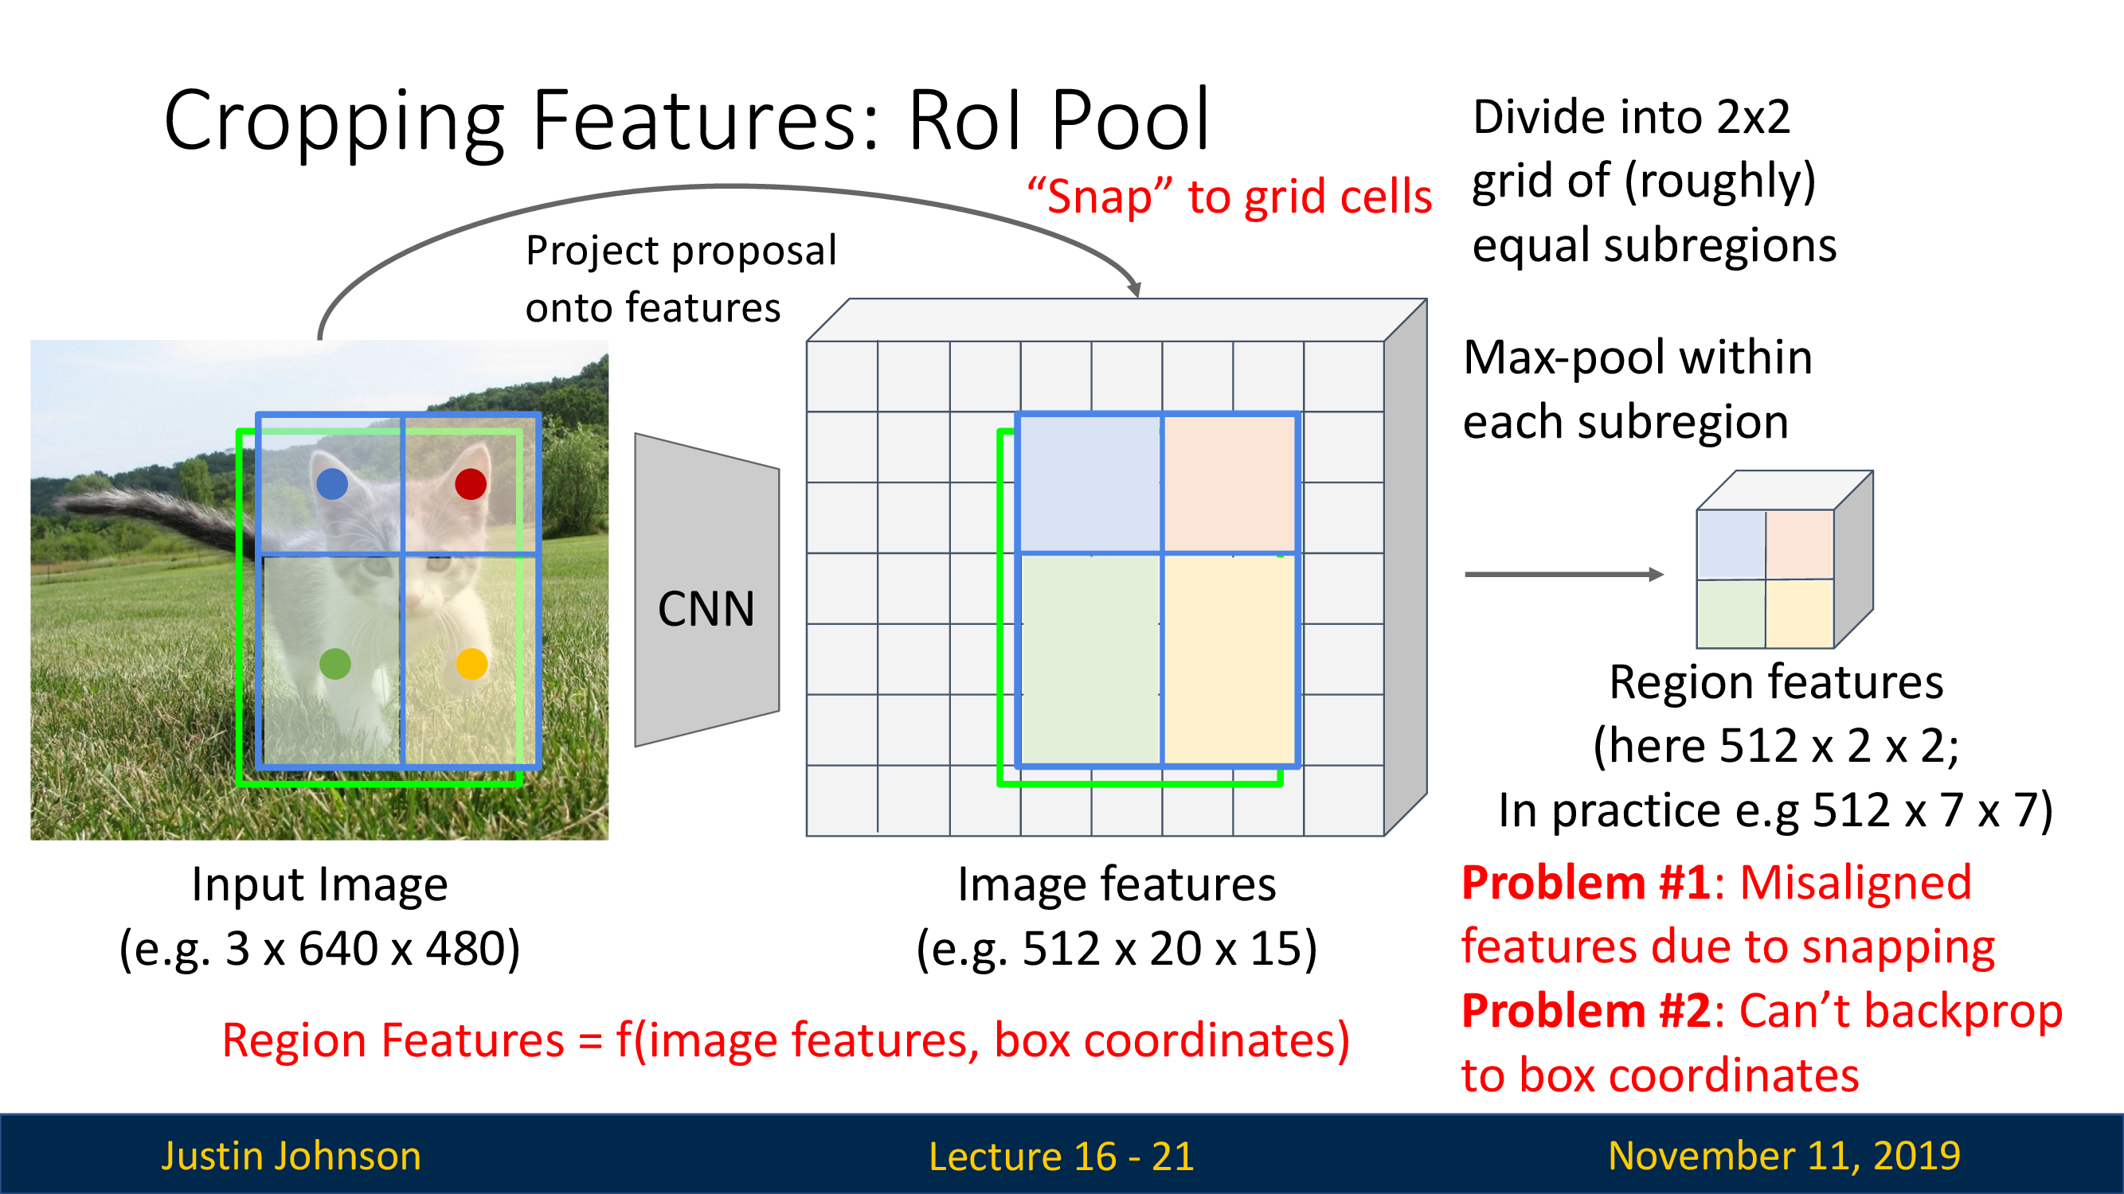
RoI pooling

Slide 45
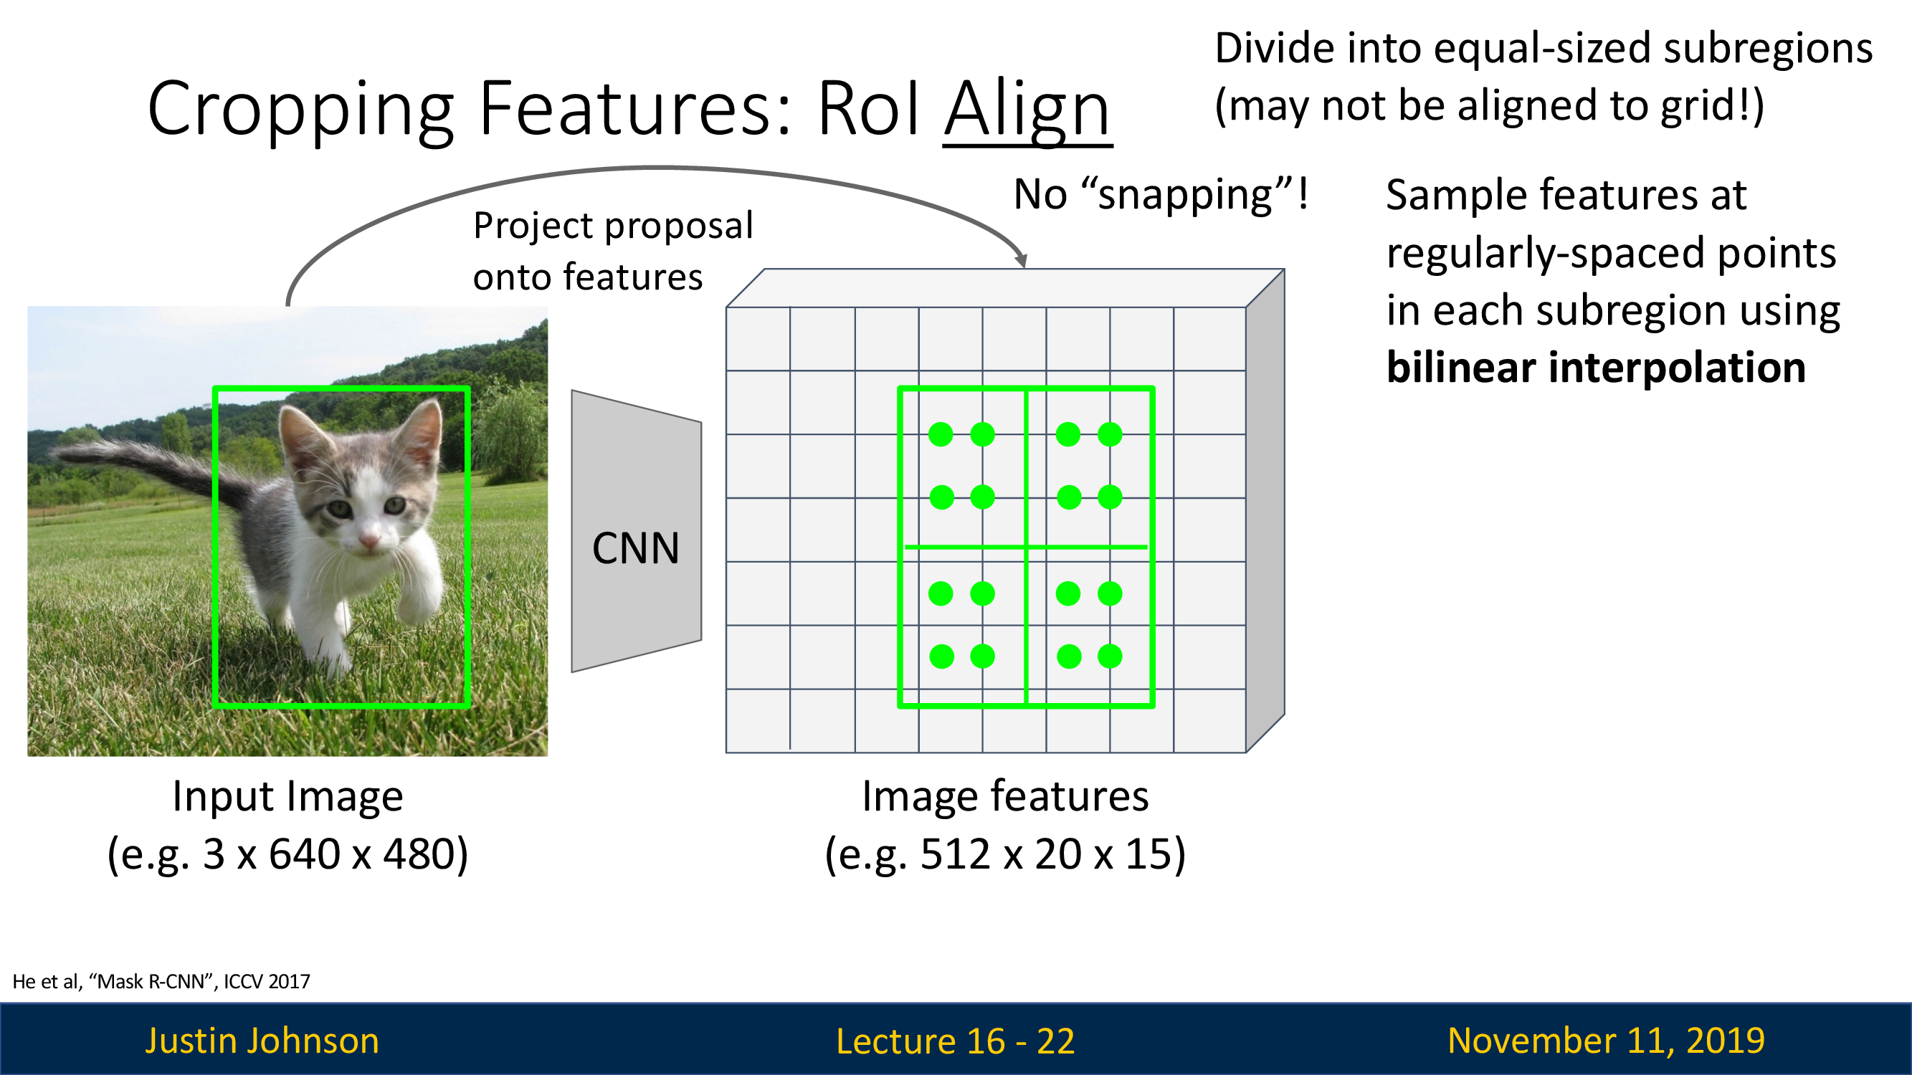
RoI Align

Slide 46
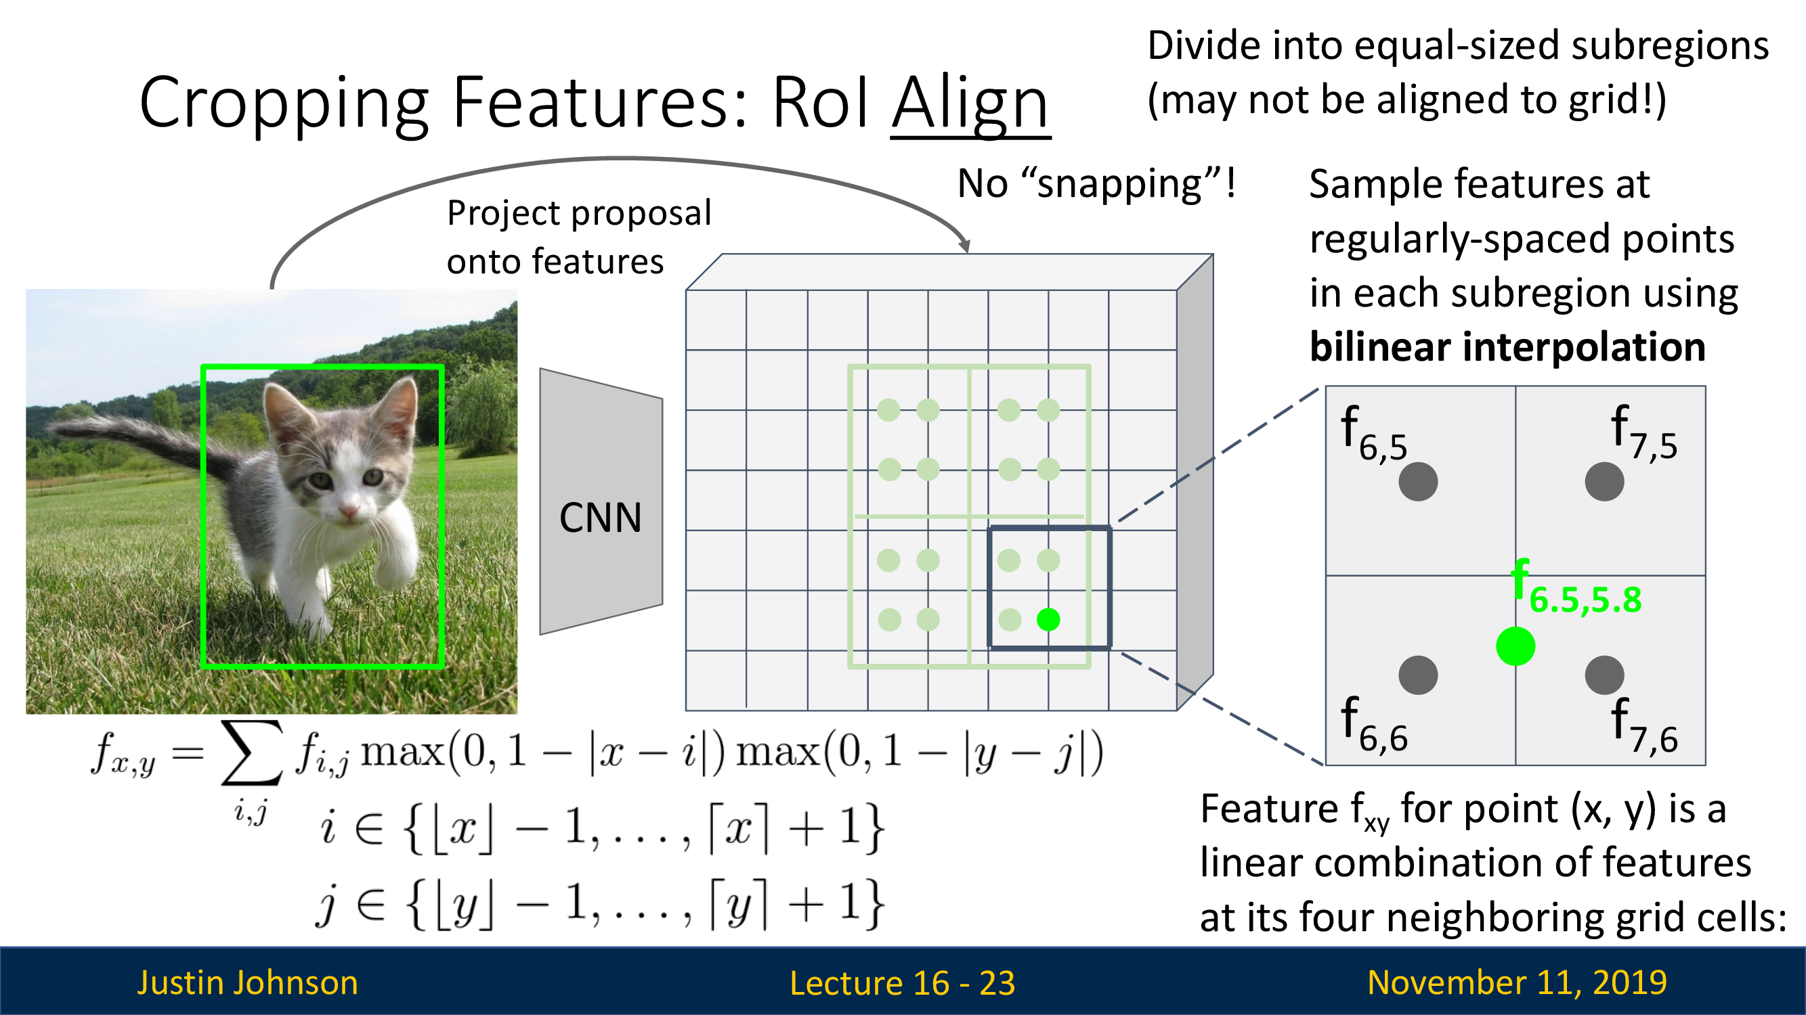
RoI Align

Slide 47
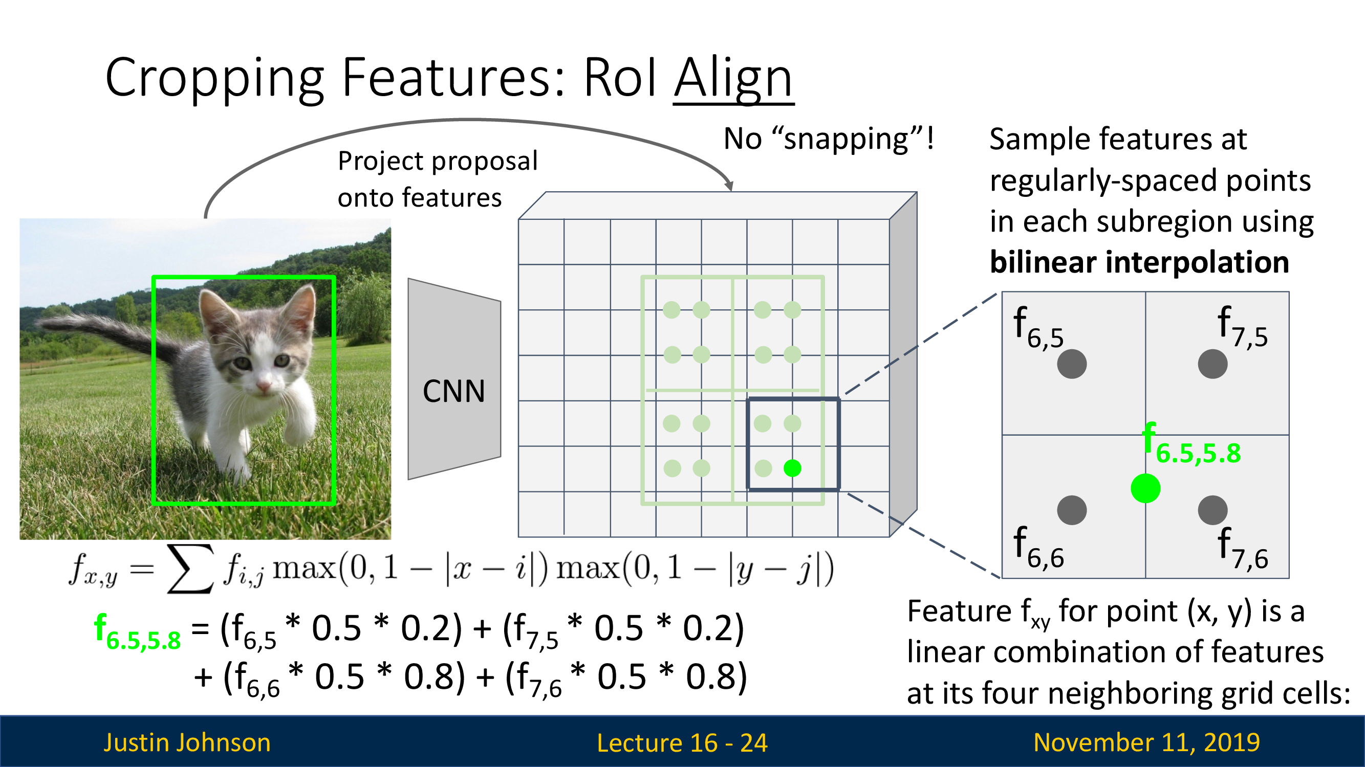
RoI Align

Slide 48
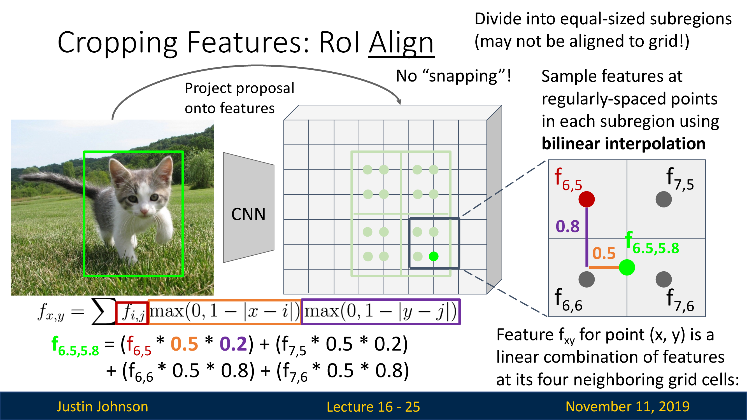
RoI Align

Slide 49
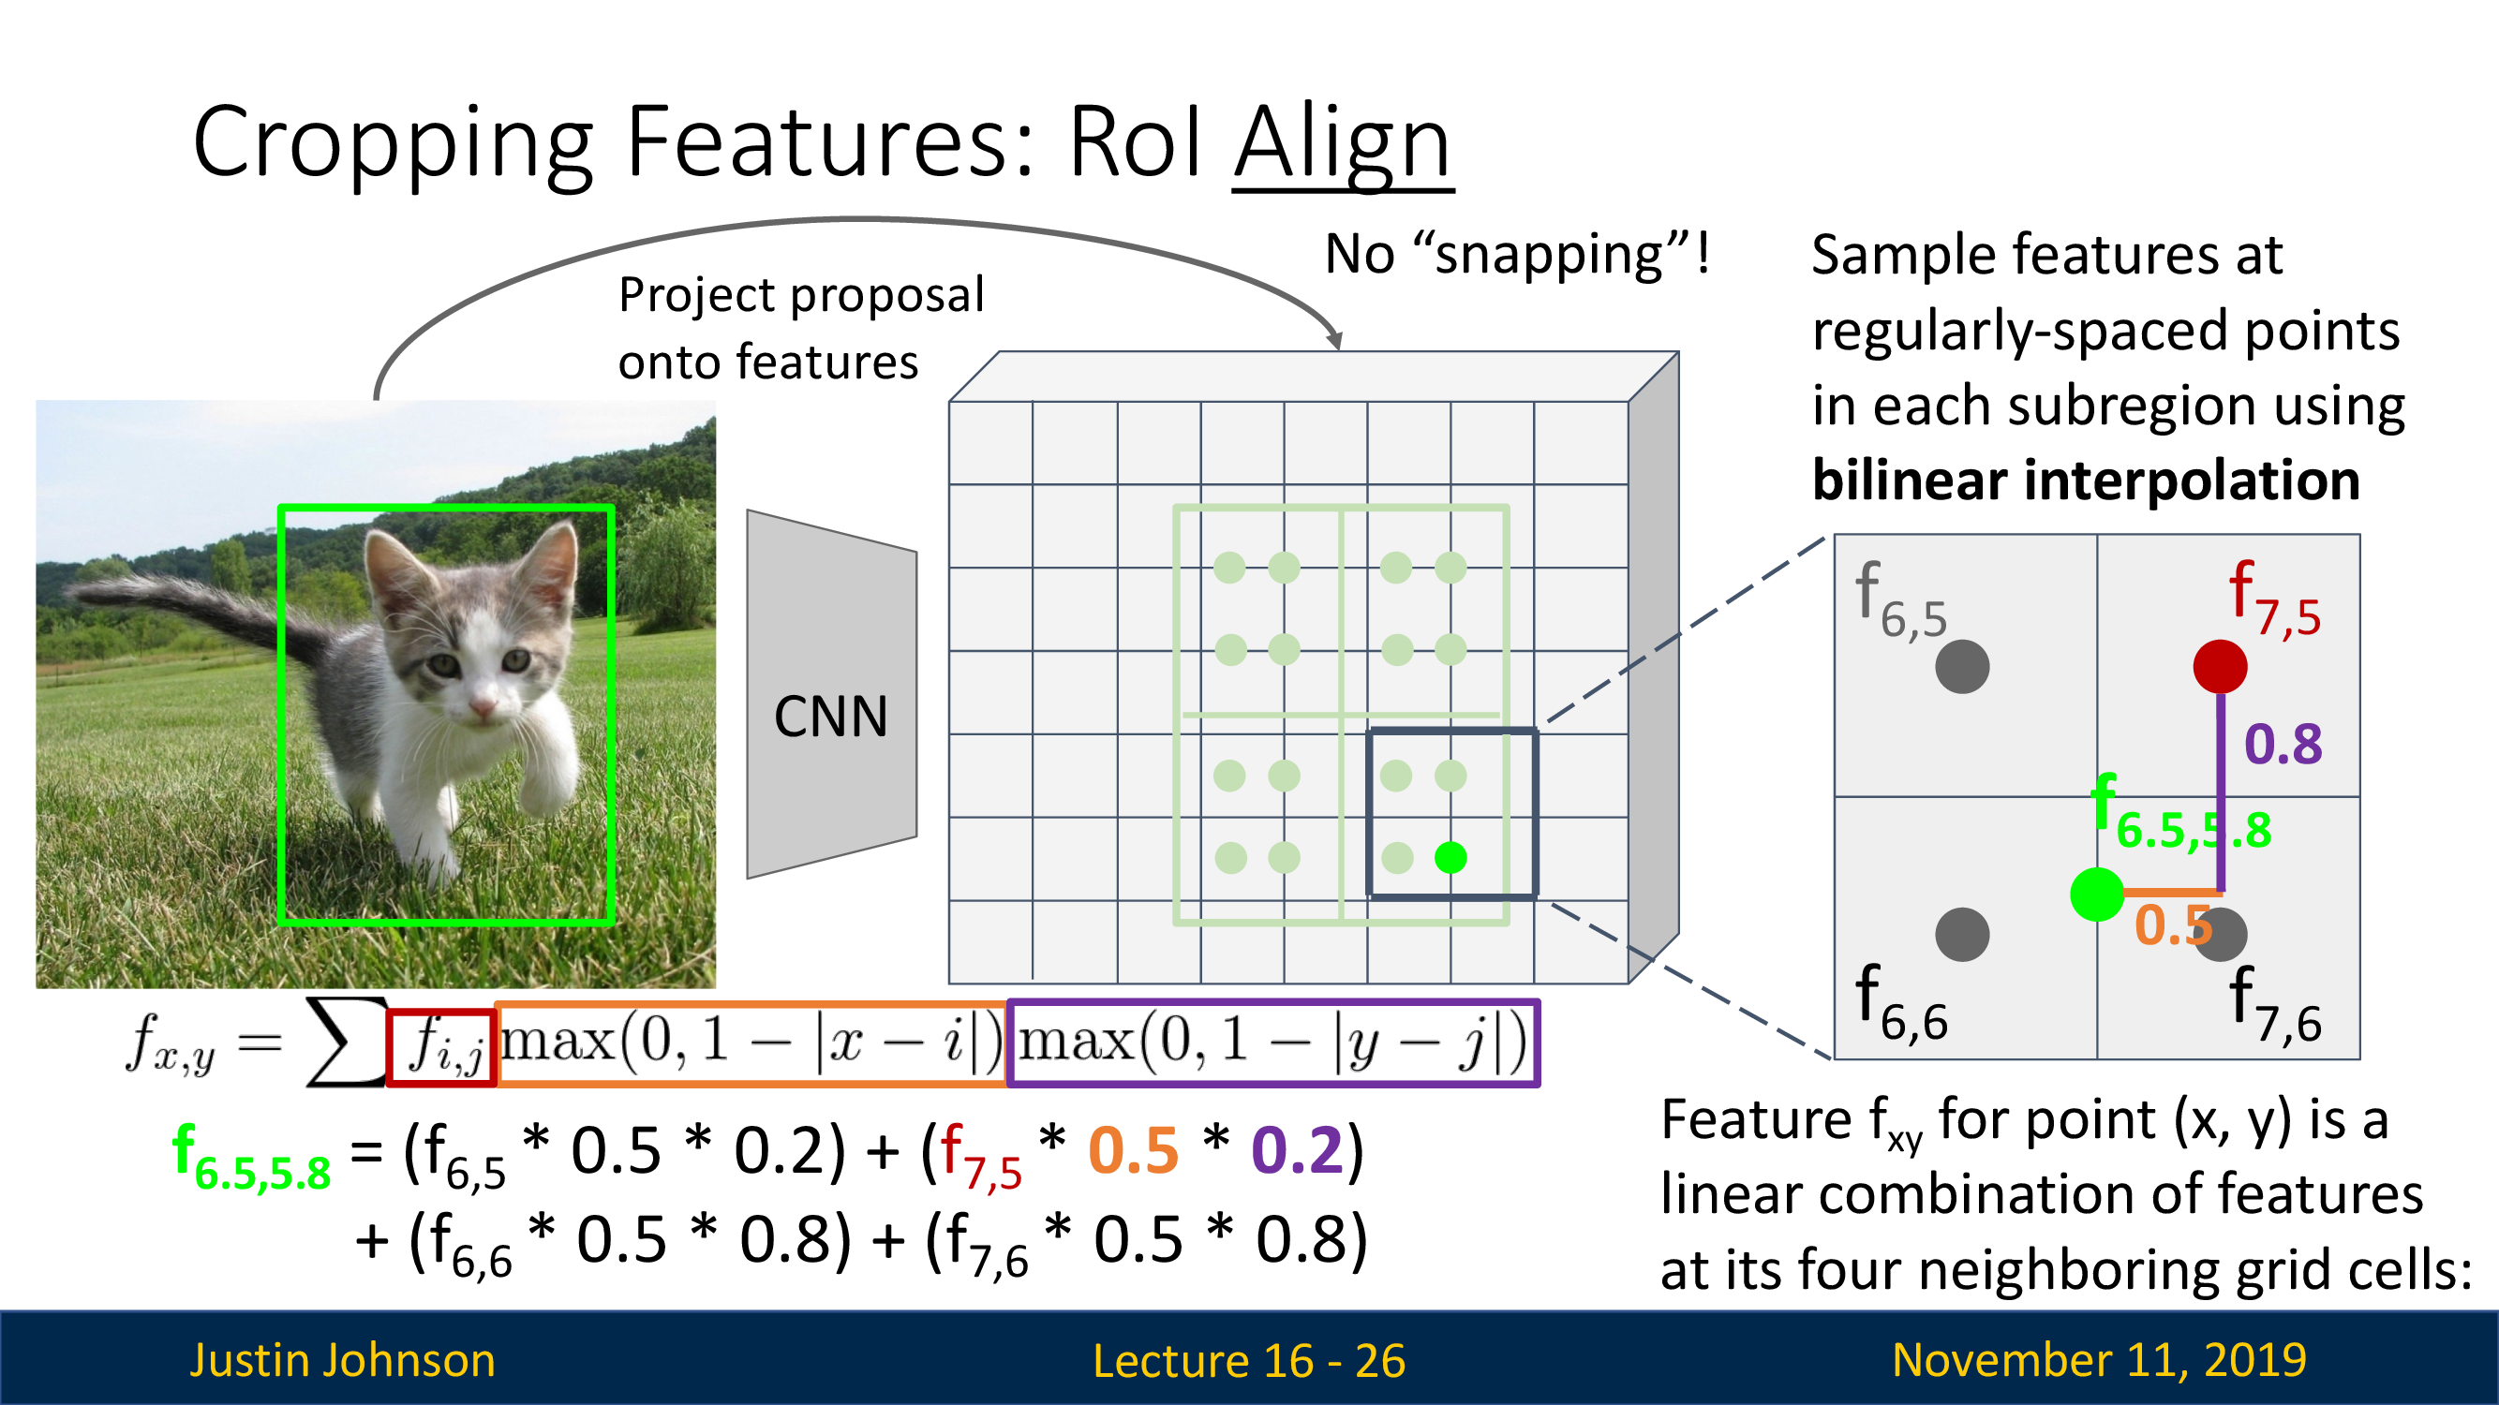
RoI Align

Slide 50
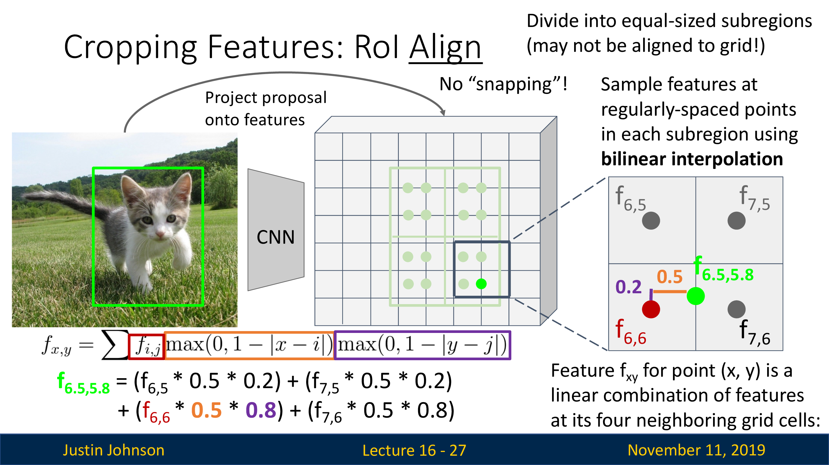
RoI Align

Slide 51
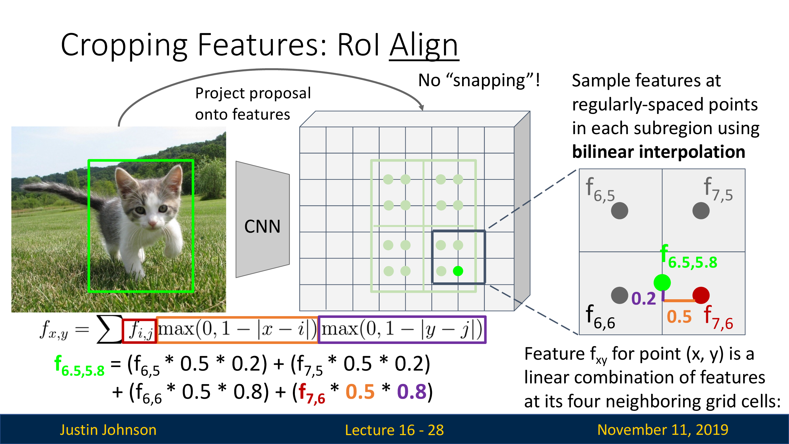
RoI Align

Slide 52
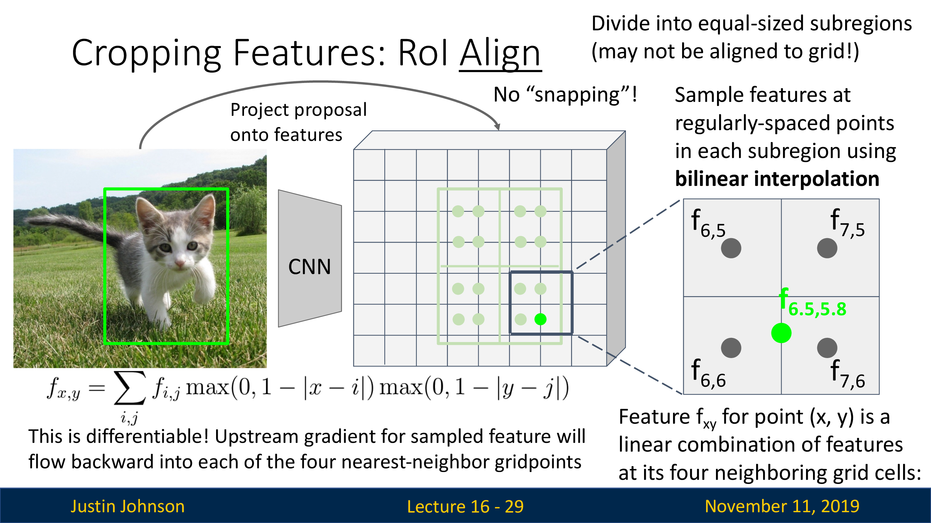
RoI Align

Slide 53
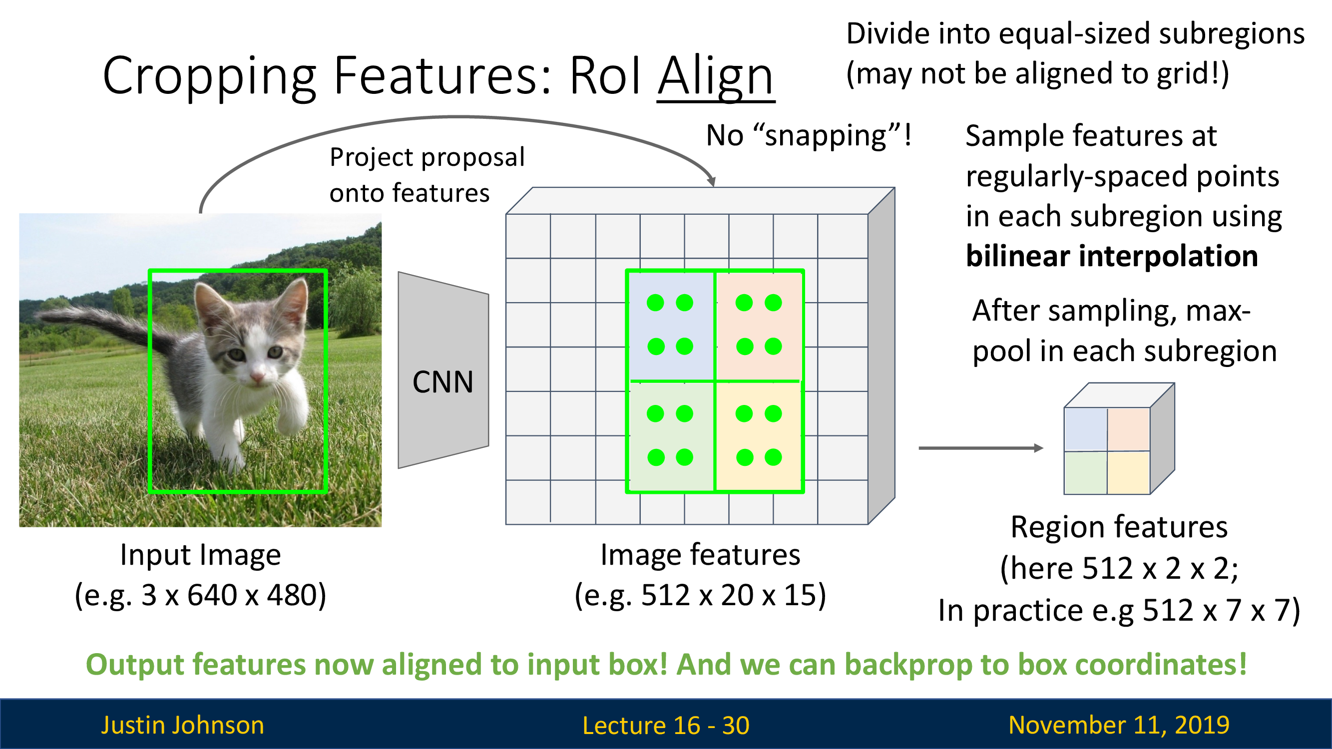
RoI Align

Slide 54
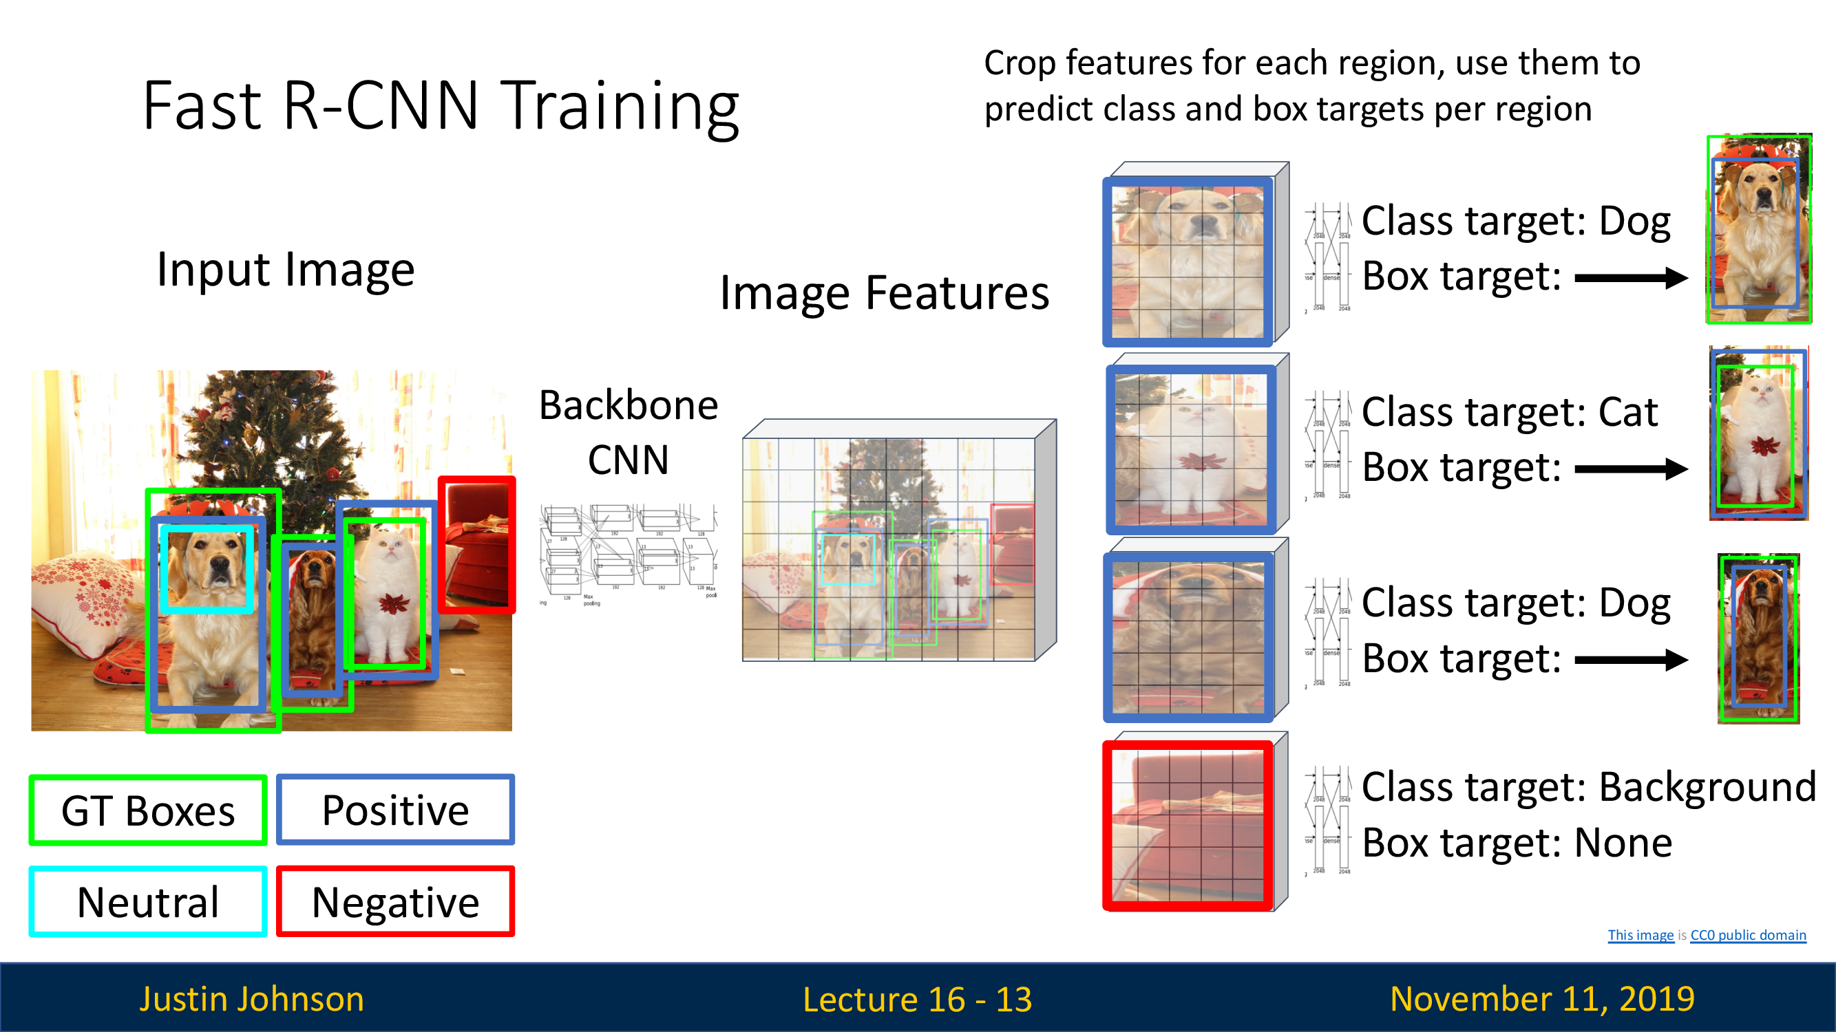
Fast R-CNN

Slide 55
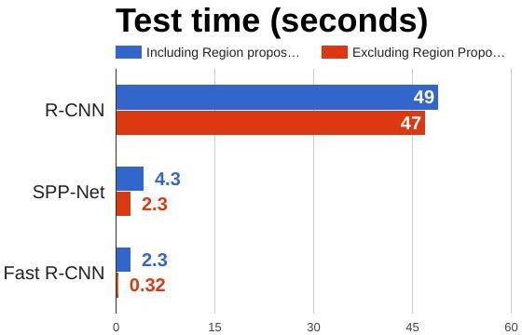
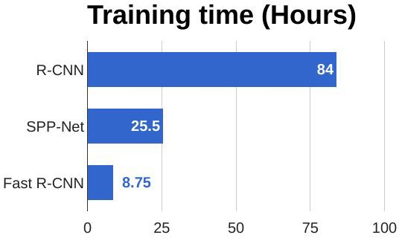
R-CNN vs Fast R-CNN
Girshick et al, “Rich feature hierarchies for accurate object detection and semantic segmentation”, CVPR 2014. He et al, “Spatial pyramid pooling in deep convolutional networks for visual recognition”, ECCV 2014
Girshick, “Fast R-CNN”, ICCV 2015

Slide 56
R-CNN vs Fast R-CNN
Problem:
Runtime dominated by region proposals!
Girshick et al, “Rich feature hierarchies for accurate object detection and semantic segmentation”, CVPR 2014. He et al, “Spatial pyramid pooling in deep convolutional networks for visual recognition”, ECCV 2014
Girshick, “Fast R-CNN”, ICCV 2015

Slide 57
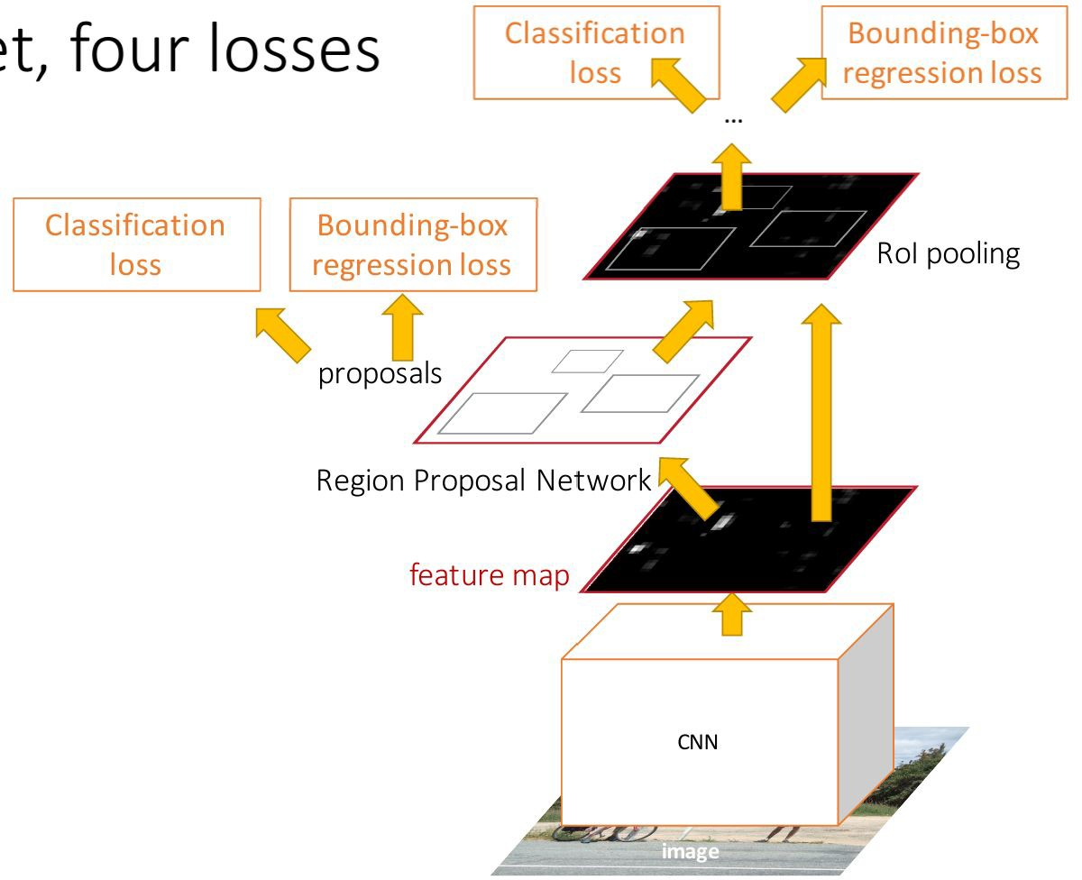
Make CNN do proposals!
Faster R-CNN
Insert Region Proposal Network (RPN) to predict proposals from features
Otherwise same as Fast R-CNN: Crop features for each proposal, classify each one
Ren et al, “Faster R-CNN: Towards Real-Time Object Detection with Region Proposal Networks”, NIPS 2015 Figure copyright 2015, Ross Girshick; reproduced with permission

Slide 58
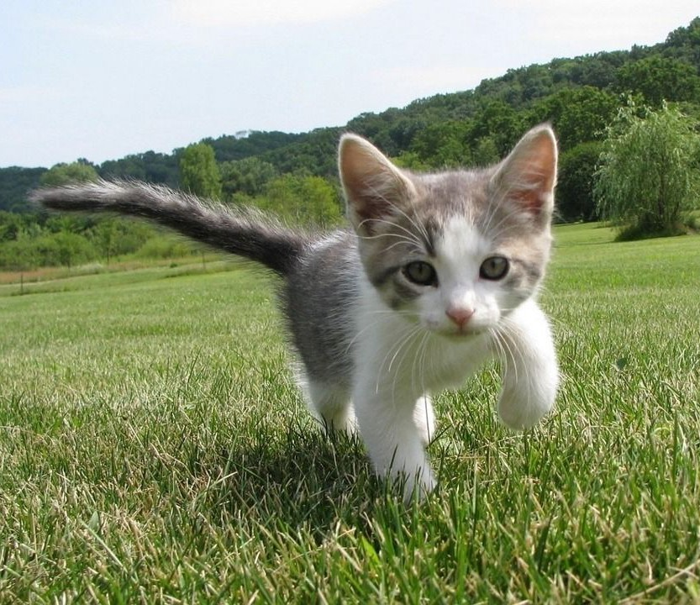
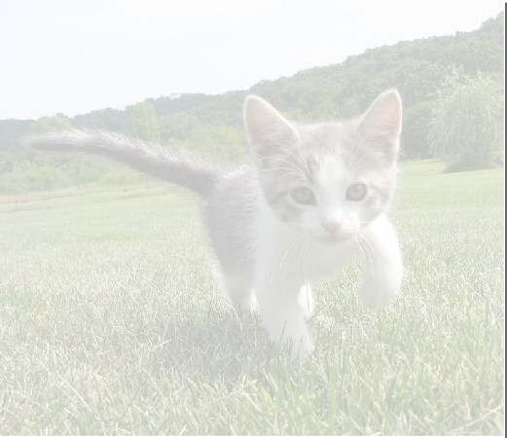
Region Proposal Network
Faster R-CNN
CNN
Input Image (e.g. 3 x 640 x 480)
Image features (e.g. 512 x 20 x 15)

Slide 59
Region Proposal Network
Faster R-CNN
Imagine an anchor box of fixed size at each point in the feature map
CNN
Input Image (e.g. 3 x 640 x 480)
Image features
(e.g. 512 x 20 x 15)

Slide 60
Region Proposal Network
Faster R-CNN
Imagine an anchor box of fixed size at each point in the feature map
Anchor is an object?
1 x 20 x 15
CNN
Conv
At each point, predict whether the corresponding anchor contains an object (binary classification)
Input Image (e.g. 3 x 640 x 480)
Image features
(e.g. 512 x 20 x 15)

Slide 61
Region Proposal Network
Faster R-CNN
Imagine an anchor box of fixed size at each point in the feature map
Anchor is an object?
1 x 20 x 15
CNN
Conv
Box corrections 4 x 20 x 15
For positive boxes, also predict a corrections from the anchor to the ground-truth box (regress 4 numbers per pixel)
Input Image (e.g. 3 x 640 x 480)
Image features (e.g. 512 x 20 x 15)

Slide 62
In practice use K different anchor boxes of different size / scale at each point
Faster R-CNN
Region Proposal Network
Anchor is an object?
K x 20 x 15
CNN
Conv
Box transforms
4K x 20 x 15
Input Image (e.g. 3 x 640 x 480)
Image features (e.g. 512 x 20 x 15)

Slide 63
In practice use K different anchor boxes of different size / scale at each point
Faster R-CNN
Region Proposal Network
Anchor is an object?
K x 20 x 15
CNN
Conv
Box transforms
4K x 20 x 15
Sort the K*20*15 boxes by their “objectness” score, take top ~300 as our proposals
Input Image (e.g. 3 x 640 x 480)
Image features (e.g. 512 x 20 x 15)

Slide 64
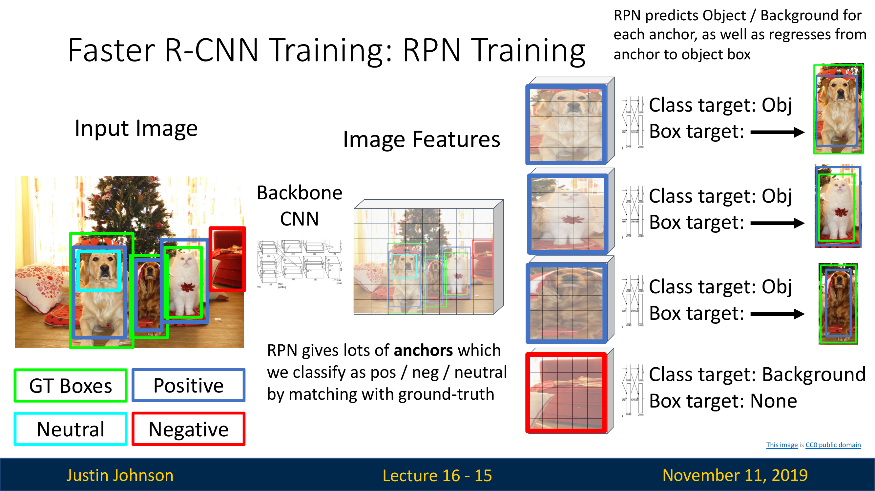
Faster R-CNN

Slide 65
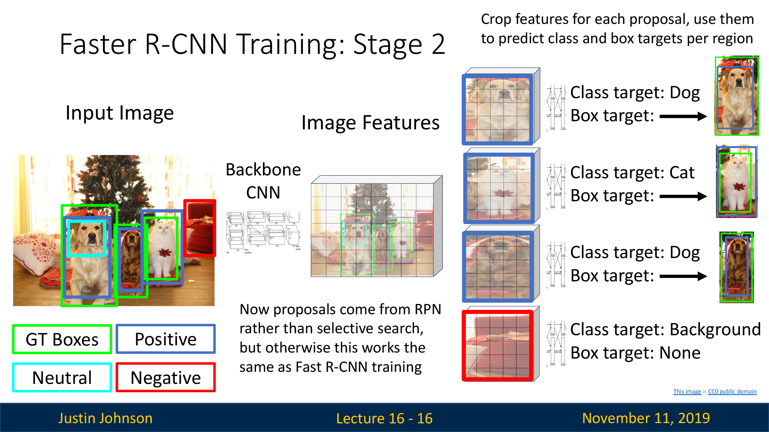
Faster R-CNN

Slide 66
Make CNN do proposals!
Faster R-CNN
Jointly train with 4 losses:
RPN classify object / not object
RPN regress box coordinates
Final classification score (object classes)
Final box coordinates
Ren et al, “Faster R-CNN: Towards Real-Time Object Detection with Region Proposal Networks”, NIPS 2015 Figure copyright 2015, Ross Girshick; reproduced with permission

Slide 67
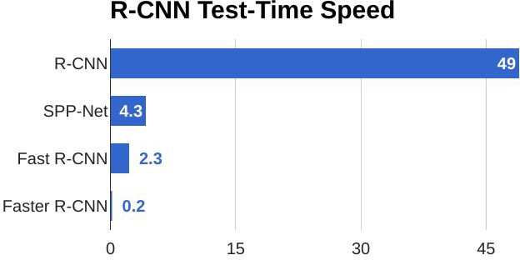
Make CNN do proposals!
Faster R-CNN

Slide 68
Faster R-CNN
Make CNN do proposals!
Faster R-CNN is a
Two-stage object detector
First stage: Run once per image
Backbone network
Region proposal network
Second stage: Run once per region
Crop features: RoI pool / align
Predict object class
Prediction bbox offset

Slide 69
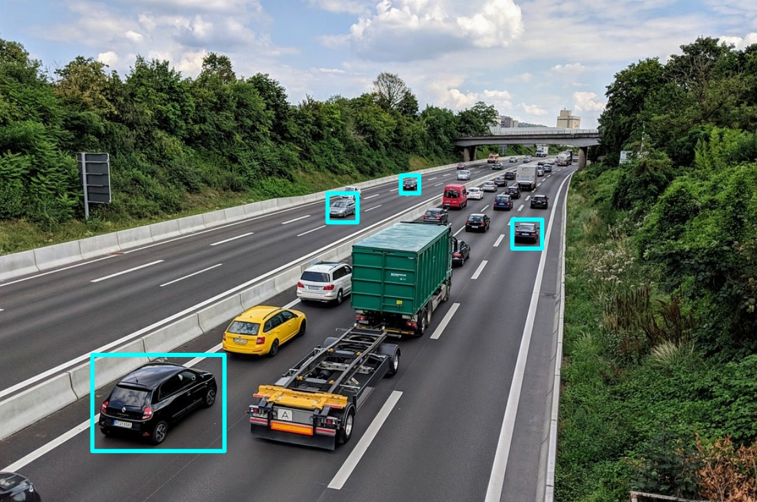
Dealing with Scale
▶ We need to detect objects of many different scales.
▶ How to improve scale invariance of the detector

Slide 70
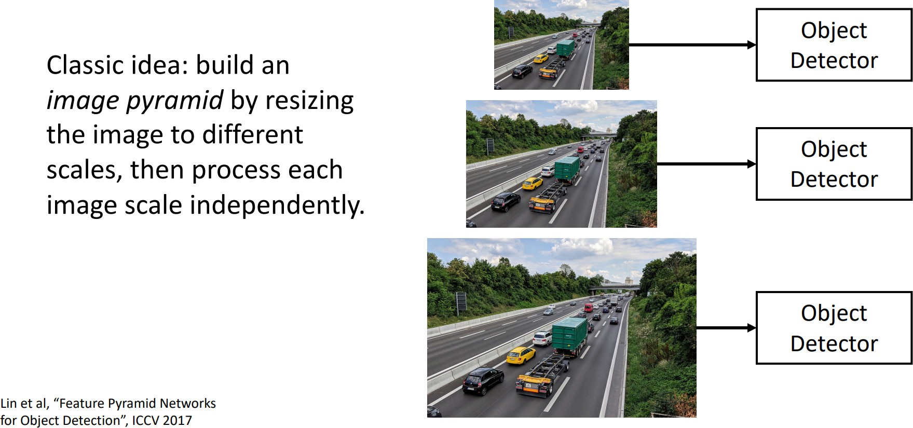
Dealing with Scale: Image Pyramid

Slide 71
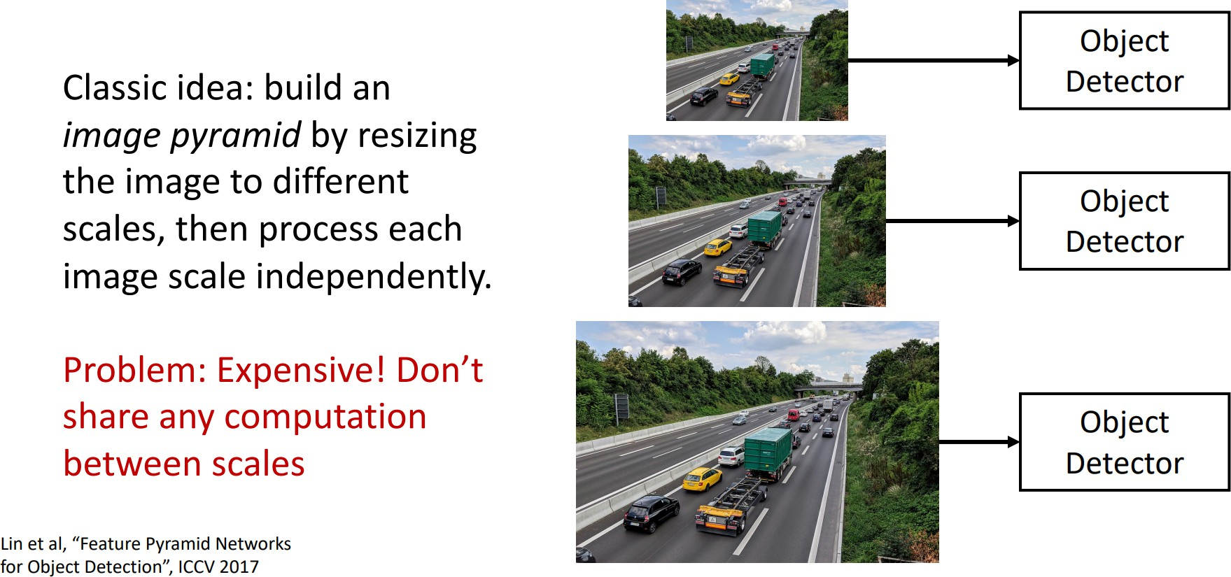
Dealing with Scale: Image Pyramid (cont.)

Slide 72
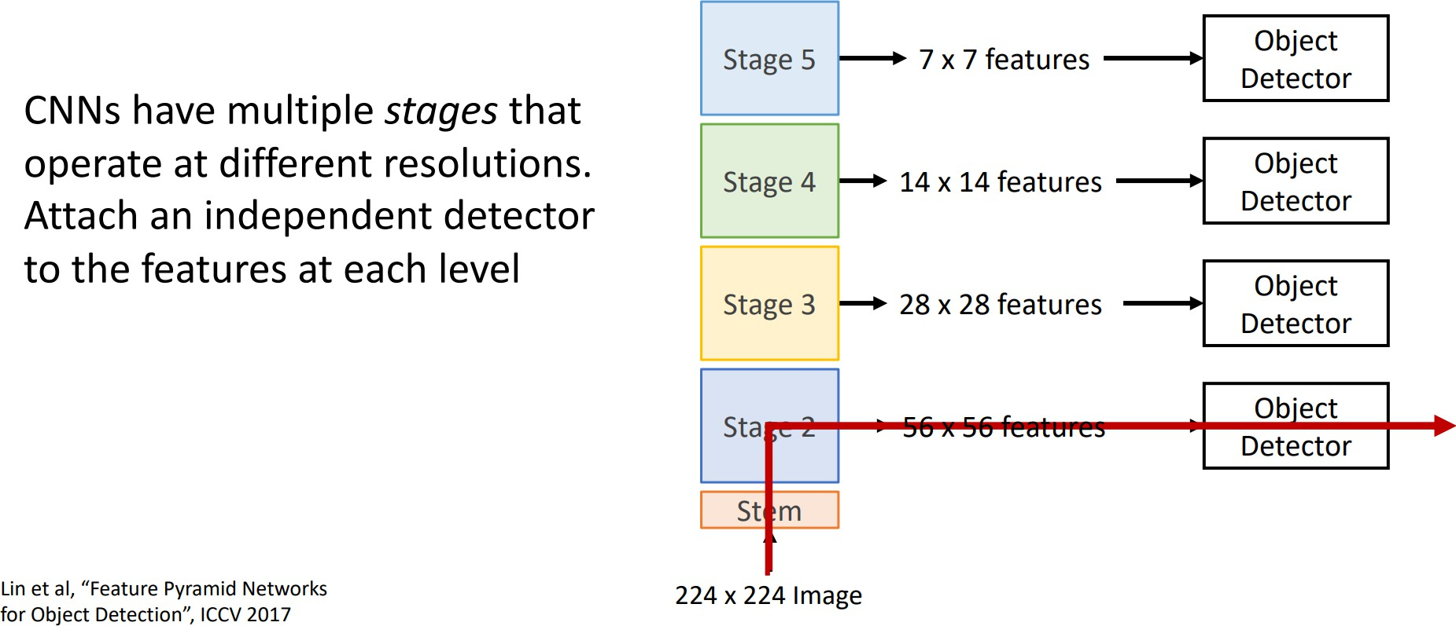
Dealing with Scale: Image Pyramid

Slide 73

Dealing with Scale: Image Pyramid (cont.)

Slide 74

Dealing with Scale: Feature Pyramid Network

Slide 75

Dealing with Scale: Feature Pyramid Network (cont.)

Slide 76

Dealing with Scale: Feature Pyramid Network (cont.)

Slide 77

Overlapping Boxes: Non-Max Suppression (NMS)
▶ Problem: Object detectors often output many overlapping detections

Slide 78
Overlapping Boxes: Non-Max Suppression (NMS)
▶ Problem: Object detectors often output many overlapping detections
▶ Solution: Post-process raw detections using Non-Max Suppression (NMS)

Slide 79
Overlapping Boxes: Non-Max Suppression (NMS)
▶ Problem: Object detectors often output many overlapping detections
▶ Solution: Post-process raw detections using Non-Max Suppression (NMS)
Select next highest-scoring
box
Eliminate lower-scoring boxes
with IoU > threshold (e.g. 0.7)
If any boxes remain, GOTO 1

Slide 80

Overlapping Boxes: Non-Max Suppression (NMS)
▶ Problem: Object detectors often output many overlapping detections
▶ Solution: Post-process raw detections using Non-Max Suppression (NMS)
Select next highest-scoring
box
Eliminate lower-scoring boxes
with IoU > threshold (e.g. 0.7)
If any boxes remain, GOTO 1

Slide 81

Overlapping Boxes: Non-Max Suppression (NMS)
▶ Problem: Object detectors often output many overlapping detections
▶ Solution: Post-process raw detections using Non-Max Suppression (NMS)
Select next highest-scoring
box
Eliminate lower-scoring boxes
with IoU > threshold (e.g. 0.7)
If any boxes remain, GOTO 1
▶ Problem: NMS may eliminate ”good” boxes when objects are highly overlapping. . . no good solution =(

Slide 82

Single Shot Object Detection

Slide 83

YOLO - Overview

Slide 84

YOLO algorithm
Labels for training For each grid cell:
100
100
[Redmon et al., 2015, You Only Look Once: Unified real-time object detection]

Slide 85



Anchor boxes
YOLO algorithm
Anchor box 1:
Anchor box 2:
p_{c} b_{x} b_{y} b_{h} b_{w}
c₁ c₂ c₃
y =
[Redmon et al., 2015, You Only Look Once: Unified real-time object detection]
Andrew Ng

Slide 86
Anchor box example
YOLO algorithm
p_{c} b_{x} b_{y} b_{h} b_{w}
c₁ c₂ c₃
p_{c} b_{x} b_{y} b_{h} b_{w}
c₁ c₂ c₃
y =
Anchor box 1:
Anchor box 2:
Andrew Ng

Slide 87

YOLO Training
YOLO algorithm
- pedestrian
- car
- motorcycle
p_{c} b_{x} b_{y} b_{h} b_{w}
c₁ c₂ c₃
p_{c} b_{x} b_{y} b_{h} b_{w}
c₁ c₂ c₃
0
?
?
?
?
?
?
? 0
?
?
?
?
?
?
?
0
?
?
?
?
?
?
? 1
b_{x} b_{y} b_{h} b_{w}
0
1
0
y
=
y is 3×3×2×8
[Redmon et al., 2015, You Only Look Once: Unified real-time object detection]
Andrew Ng

Slide 88
Making predictions
YOLO algorithm
p_{c} b_{x} b_{y} b_{h} b_{w}
c₁ c₂ c₃
p_{c} b_{x} b_{y} b_{h} b_{w}
c₁ c₂ c₃
⋯
y =
3×3×2×8
Andrew Ng

Slide 89

YOLO

Slide 90

YOLO

Slide 91

YOLO

Slide 92
YOLO
Each cell predicts

Slide 93

YOLO
Each cell predicts
▶ B = 2 bounding boxes (x, y, w, h)+ confidence score

Slide 94
YOLO
Each cell predicts
▶ B = 2 bounding boxes (x, y, w, h)+ confidence score
▶ C = 20 class probabilities

Slide 95

YOLO
Each cell predicts
▶ B = 2 bounding boxes (x, y, w, h)+ confidence score
▶ C = 20 class probabilities

Slide 96

YOLO
Each cell predicts
▶ B = 2 bounding boxes (x, y, w, h)+ confidence score
▶ C = 20 class probabilities

Slide 97

YOLO
Each cell predicts
▶ B = 2 bounding boxes (x, y, w, h)+ confidence score
▶ C = 20 class probabilities

Slide 98

YOLO
Each cell predicts
▶ B = 2 bounding boxes (x, y, w, h)+ confidence score
▶ C = 20 class probabilities
▶ Apply Non-Maximum Suppression

Slide 99

YOLO - Loss Function

Slide 100


YOLO - Benefits
▶ Fast. Good for real-time processing
▶ End-to-end training

Slide 101

YOLO - Limitations

Slide 102
YOLO - Limitations
▶ Difficult to detect small objects
▶ Coarse predictions

Slide 103

YOLO - Limitations
▶ Difficult to detect small objects
▶ Coarse predictions
▶ Fixed input size

Slide 104

YOLO - Limitations
▶ Difficult to detect small objects
▶ Coarse predictions
▶ Fixed input size
▶ A grid cell can predict only one class

Slide 105
YOLO - Limitations
▶ Difficult to detect small objects
▶ Coarse predictions
▶ Fixed input size
▶ A grid cell can predict only one class
▶ Solutions:
Remove fc layers!
Predict class per bbox (not per cell)

Slide 106

YOLOv2
▶ Removed fully connected layers
▶ A grid cell predicts class probabilities for each box

Slide 107
There’s always room for improvement!
▶ YOLOv3
J. Redmon, A. Farhadi. Yolov3: An incremental improvement, 2018
▶ YOLOv4
A. Bochkovskiy, C. Wang, H. Liao. Yolov4: Optimal speed and accuracy of object detection (Feb. 2020)
▶ YOLOv5
YOLOv5 by ultralytics (June 2020)
▶ PP-YOLO
X. Long, K. Deng, G. Wang, Y. Zhang, Q. Dang, Y. Gao, H. Shen,
J. Ren, S. Han, E. Ding, S. Wen. Pp-yolo: An effective and efficient implementation of object detector (June 2020)
▶ PP-YOLOv2 (2021)
J. X. Huang, X. Wang, W. Lv, X. Bai, X. Long, K. Deng, Q. Dang,
S. Han, Q. Liu, X. Hu, D. Yu, Y. Ma, O. Yoshie. PP-YOLOv2: A
Practical Object Detector (2021)

Slide 108
References
These slides have been adapted from
▶ Fei-Fei Li, Yunzhu Li & Ruohan Gao, Stanford CS231n: Deep Learning for Computer Vision
▶ Assaf Shocher, Shai Bagon, Meirav Galun & Tali Dekel, WAIC DL4CV Deep Learning for Computer Vision: Fundamentals and Applications
▶ Justin Johnson, UMich EECS 498.008/598.008: Deep Learning for Computer Vision
▶ cs231n@stanford
▶ EECS 498.008 / 598.008
▶ CNN DeepLearning.AI

